Slide 1
Tutorials for Map-UI

Slide 2
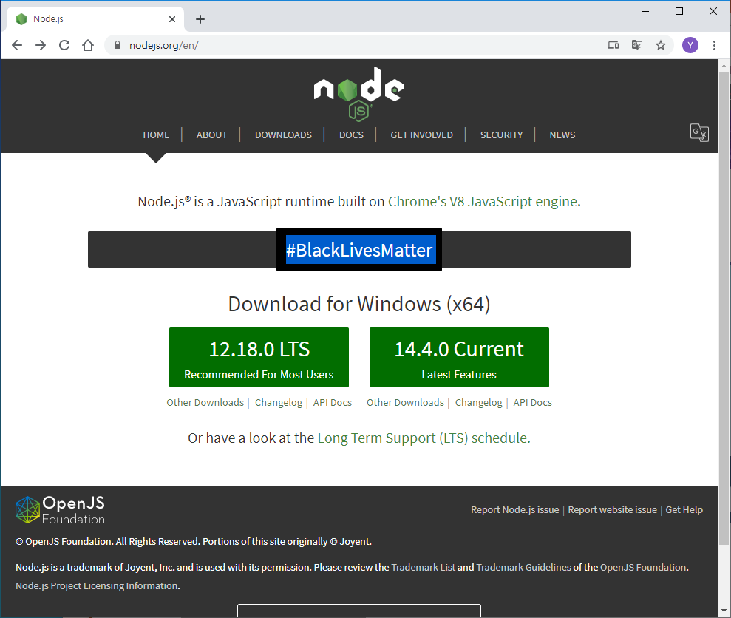
0. 설치 가이드
A. Node.js를 설치한다.
- https://nodejs.org 에서 LTS 버전을 설치한다.
C:\> npm install http-server -g
https://nodejs.org/

Slide 3
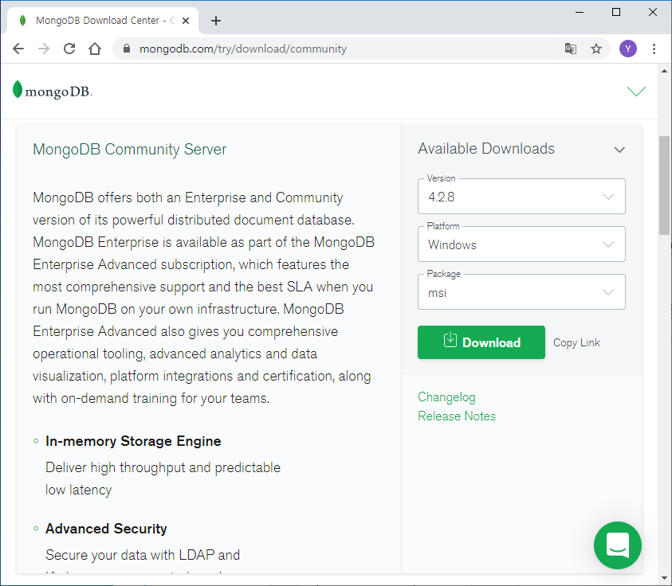
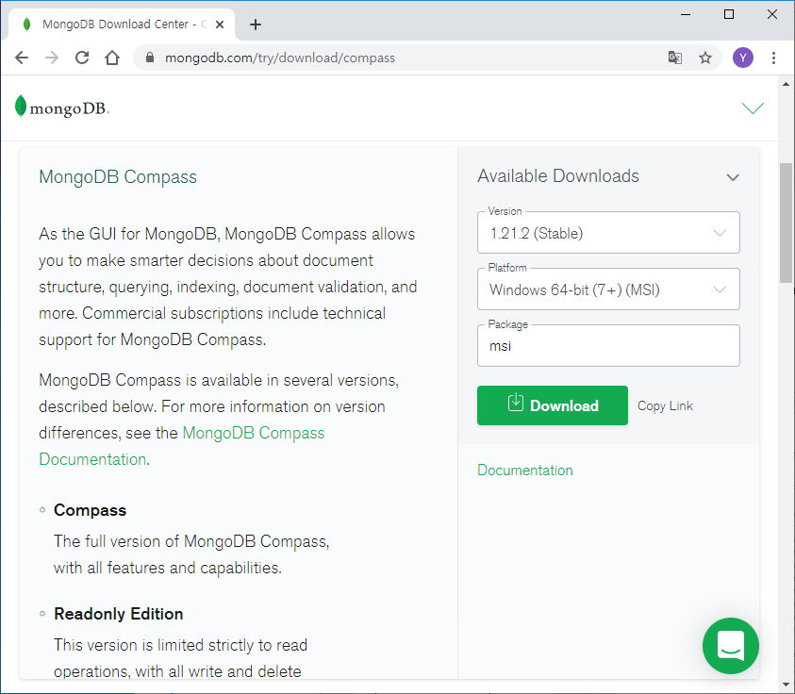
0. 설치 가이드
B. MongoDB Community Server와 Compass를 설치한다.
https://www.mongodb.com/try/download/community
https://www.mongodb.com/try/download/compass
Community version의 compass에는 기능적인 제약이 있다고 함.
MongoDB 설치할 때는 compass를 설치하지 말고
별도로 다운 받아서 설치하는 것이 좋음.

Slide 4
0. 설치 가이드
C. Minikube를 설치한다.
- https://kubernetes.io/ko/docs/tasks/tools/install-minikube/
1) Minikube가 동작하기 위해서 가상화 서비스가 필요하다.
Windows 10 Enterprise / Professional에서는 Hyper-V를 사용하면 되고,
Windows 10 Home 등에서는 Virtual Box를 설치한다(https://www.virtualbox.org/wiki/Downloads).
2) Minikube를 설치한다.
(https://github.com/kubernetes/minikube/releases/latest/download/minikube-installer.exe)
3) Kubectl을 설치한다.
(https://kubernetes.io/ko/docs/tasks/tools/install-kubectl/)

Slide 5
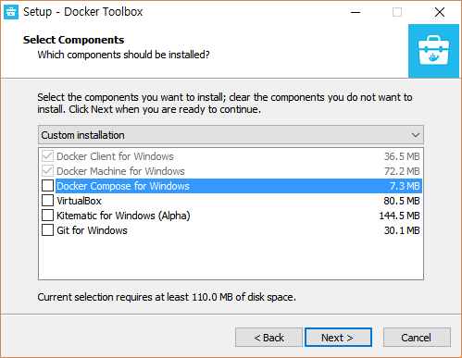
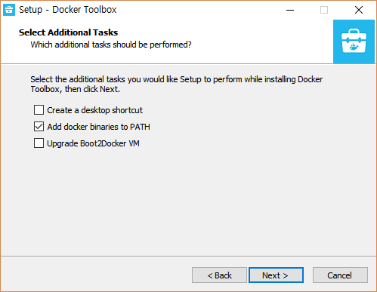
0. 설치 가이드
D. Docker Toolbox를 설치한다.
- https://download.docker.com/win/stable/DockerToolbox.exe
- Docker Engine과 Client만 설치함. Boot2Docker VM도 하지 않음.
Docker Quickstart Terminal 도 사용하지 않음.

Slide 6
1. Google Maps API 가이드
Google Map 보이기(tutorials/google-maps/index1.html)
<!DOCTYPE html>
<html>
<head>
<title>Google Maps Tutorial</title>
<style type="text/css">
/* Always set the map height explicitly to define the size of the div
* element that contains the map. */
#map {
height: 100%;
}
/* Makes the sample page fill the window. */
html,
body {
height: 100%;
margin: 0;
padding: 0;
}
</style>
<script>
function initMap() {
// The location of seoul station
var seoul = { lng: 126.9706673, lat: 37.5547787 };
var options = {
center: seoul,
zoom: 15,
};
var map = new google.maps.Map(document.getElementById('map'), options);
}
</script>
<script async defer
src="https://maps.googleapis.com/maps/api/js?key=YOUR_KEY&callback=initMap">
</script>
</head>
<body>
<div id="map"></div>
</body>
</html>

Slide 7
1. Google Maps API 가이드
Marker 보이기(tutorials/google-maps/index2.html)
<!DOCTYPE html>
<html>
<head>
<title>Google Maps Tutorial</title>
<style type="text/css">
/* Always set the map height explicitly to define the size of the div
* element that contains the map. */
#map {
height: 100%;
}
/* Makes the sample page fill the window. */
html,
body {
height: 100%;
margin: 0;
padding: 0;
}
</style>
<script>
function initMap() {
// The location of seoul station
var seoul = { lng: 126.9706673, lat: 37.5547787 };
var options = {
center: seoul,
zoom: 15,
};
var map = new google.maps.Map(document.getElementById('map'), options);
var marker = new google.maps.Marker({ position: seoul, map: map });
}
</script>
<script async defer
src="https://maps.googleapis.com/maps/api/js?key=YOUR_KEY&callback=initMap">
</script>
</head>
<body>
<div id="map"></div>
</body>
</html>

Slide 8
1. Google Maps API 가이드
여러 개의 Marker 보이기(tutorials/google-maps/index3.html)
<script>
function initMap() {
// The location of seoul station
var seoul = { lng: 126.9706673, lat: 37.5547787 };
var options = {
center: seoul,
zoom: 15,
};
var map = new google.maps.Map(document.getElementById('map'), options);
// var marker = new google.maps.Marker({ position: seoul, map: map });
var locations = [
{ lng: 126.97081750370484, lat: 37.55506788676746 },
{ lng: 126.97714751697998, lat: 37.56547786297515 },
{ lng: 126.98303263797399, lat: 37.57004847771681 },
];
var markers = [];
for (var i = 0; i < locations.length; i++){
markers[i] = new google.maps.Marker({ position: locations[i], map: map });
}
}
</script>

Slide 9
1. Google Maps API 가이드
클러스터링(tutorials/google-maps/index4.html)
<script>
function initMap() {
var map = new google.maps.Map(document.getElementById('map'), { center: { lng: 126.9706673, lat: 37.5547787 }, zoom: 15 });
var locations = [
{ lng: 126.97081750370484, lat: 37.55506788676746 },
{ lng: 126.97714751697998, lat: 37.56547786297515 },
{ lng: 126.98303263797399, lat: 37.57004847771681 },
];
var markers = locations.map(function(location, i){
return new google.maps.Marker({ position: location, map: map });
});
// Add a marker clusterer to manage the markers.
var markerCluster = new MarkerClusterer(map, markers,
{ imagePath: 'https://developers.google.com/maps/documentation/javascript/examples/markerclusterer/m' });
}
</script>
<script src="https://unpkg.com/@google/markerclustererplus@4.0.1/dist/markerclustererplus.min.js" />
<script async defer
src=https://maps.googleapis.com/maps/api/js?key=YOUR_KEY&callback=initMap />

Slide 10
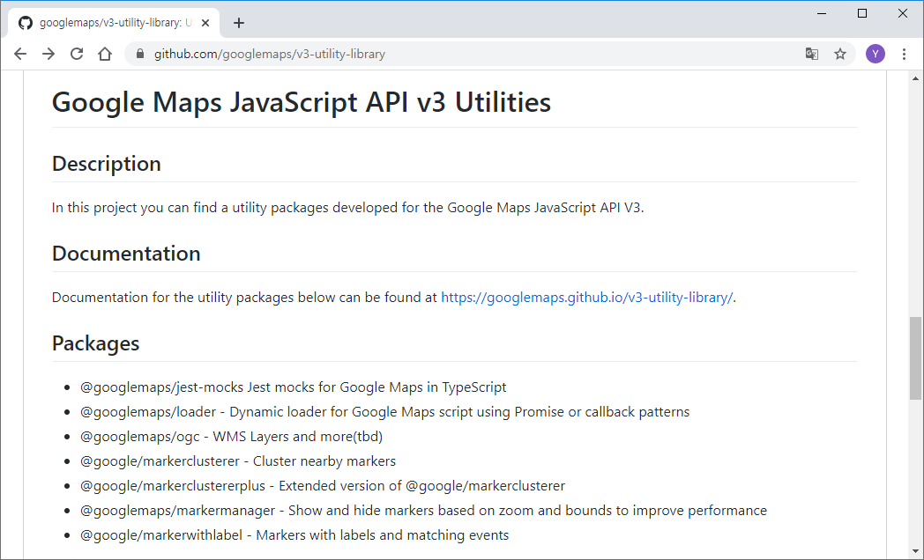
1. Google Maps API 가이드
클러스터링(tutorials/google-maps/index4.html)

Slide 11
1. Google Maps API 가이드
마우스 이벤트(tutorials/google-maps/index5.html)
<script>
function initMap() {
var map = new google.maps.Map(document.getElementById('map'), { center: { lng: 126.9706673, lat: 37.5547787 }, zoom: 15 });
var locations = [
{ lng: 126.97081750370484, lat: 37.55506788676746 },
{ lng: 126.97714751697998, lat: 37.56547786297515 },
{ lng: 126.98303263797399, lat: 37.57004847771681 },
];
var markers = locations.map(function(location, i){
var marker = new google.maps.Marker({ position: location, map: map });
marker.addListener('click', function(e){
var position = marker.getPosition();
infowindow.setPosition(position);
infowindow.setContent("{ lng: " + position.lng() + ", lat: " + position.lat() + "}");
infowindow.open(map);
});
return marker;
});
const infowindow = new google.maps.InfoWindow();
}
</script>

Slide 12
1. Google Maps API 가이드
Google Maps Data Layer(tutorials/google-maps/index6.html)
<script>
function initMap() {
var map = new google.maps.Map(document.getElementById('map'), { center: { lng: 126.9706673, lat: 37.5547787 }, zoom: 15 });
// GeoJSON format data
var geodata = {
"type": "FeatureCollection",
"features": [
{ "type": "Feature", "geometry": { "type": "Point", "coordinates": [ 126.97081750370484, 37.55506788676746 ] },
"properties": { "name": "서울역" } },
{ "type": "Feature", "geometry": { "type": "Point", "coordinates": [ 126.97714751697998, 37.56547786297515 ] },
"properties": { "name": "시청역" } },
{ "type": "Feature", "geometry": { "type": "Point", "coordinates": [ 126.98303263797399, 37.57004847771681 ] },
"properties": { "name": "종각역" } },
]
};
map.data.addGeoJson(geodata);
}
</script>

Slide 13
1. Google Maps API 가이드
GeoJSON - https://en.wikipedia.org/wiki/GeoJSON
an open standard format designed for representing simple geographical features, along with their non-spatial attributes.
The features include points (therefore addresses and locations), line strings (therefore streets, highways and boundaries), polygons (countries, provinces, tracts of land), and multi-part collections of these types.
{
"type": "FeatureCollection",
"features": [
{ "type": "Feature", "geometry": { "type": "Point", "coordinates": [ 126.97081750370484, 37.55506788676746 ] },
"properties": { "name": "서울역" } },
{ "type": "Feature", "geometry": { "type": "Point", "coordinates": [ 126.97714751697998, 37.56547786297515 ] },
"properties": { "name": "시청역" } },
{ "type": "Feature", "geometry": { "type": "Point", "coordinates": [ 126.98303263797399, 37.57004847771681 ] },
"properties": { "name": "종각역" } },
]
}

Slide 14
1. Google Maps API 가이드
Google Maps Data Layer
Point
<<implement>>
Map
Data
Feature
<<interface>>
Geometry
1
1
1
*
1
1
1
Property
*
{ "type": "Feature", "geometry": { "type": "Point", "coordinates": [ 126.97081750370484, 37.55506788676746 ] },
"properties": { "name": "서울역" } },

Slide 15
1. Google Maps API 가이드
Styling data(tutorials/google-maps/index7.html)
<script>
function initMap() {
var map = new google.maps.Map(document.getElementById('map'), { center: { lng: 126.9706673, lat: 37.5547787 }, zoom: 15 });
// GeoJSON format data
var geodata = { … };
map.data.addGeoJson(geodata);
map.data.setStyle(function(feature){
return {
icon: {
url: "/icons/subway-24px.svg",
anchor: { x: 12, y: 12 },
labelOrigin: { x:12, y: 30 },
},
label: {
color: "#FF0000",
text: feature.getProperty("name"),
},
title: feature.getProperty("name"), // rollover text
};
});
}
</script>

Slide 16
1. Google Maps API 가이드
마우스 이벤트(tutorials/google-maps/index8.html)
<script>
function initMap() {
var map = new google.maps.Map(document.getElementById('map'), { center: { lng: 126.9706673, lat: 37.5547787 }, zoom: 15 });
// GeoJSON format data
var geodata = { … };
map.data.addGeoJson(geodata);
const infowindow = new google.maps.InfoWindow();
map.data.addListener('click', function(e){
const feature = e.feature;
const name = feature.getProperty("name");
const position = e.latLng;
infowindow.setPosition(position);
infowindow.setContent("<div align=center><img src=/icons/subway-24px.svg /><br><b>"
+ name + "</b><br>(" + position.lng() + "," + position.lat() + ")</div>");
infowindow.open(map);
});
}
</script>

Slide 17
1. Google Maps API 가이드
idle 이벤트(tutorials/google-maps/index9.html)
<script>
function initMap() {
var map = new google.maps.Map(document.getElementById('map'), { center: { lng: 126.9706673, lat: 37.5547787 }, zoom: 15 });
var geodata = { … };
map.addListener('idle', function(){
// remove all features
map.data.forEach(function(feature){
map.data.remove(feature);
});
var count = 0;
const bounds = map.getBounds();
const features = geodata.features;
for(var i = 0; i < features.length; i ++){
const coordinates = features[i].geometry.coordinates;
if (bounds.contains(new google.maps.LatLng({ lng: coordinates[0], lat: coordinates[1] }))){
map.data.addGeoJson(features[i]); count ++;
}
}
console.log(count + " data added!!!");
});
}
</script>

Slide 18
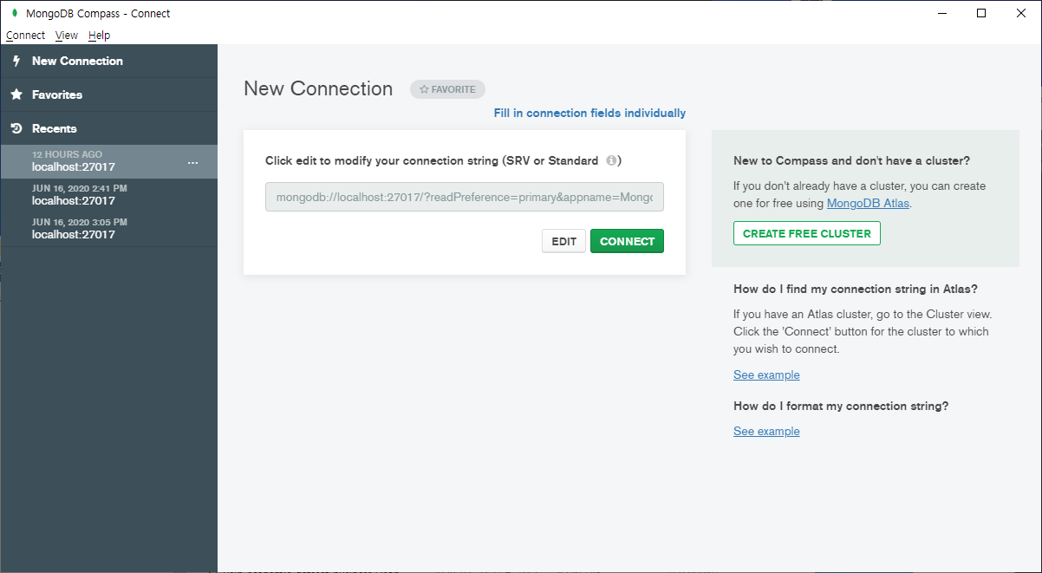
2. MongoDB 가이드
MongoDB compass (GUI client)
- MongoDB를 설치하면 서버가 실행된다. (mongodb://localhost:27017)
- CONNECT를 눌러서 서버에 연결한다.
mongodb://localhost:27017 가 디폴트이므로 입력하지 않고 CONNECT를 눌러도 된다.

Slide 19
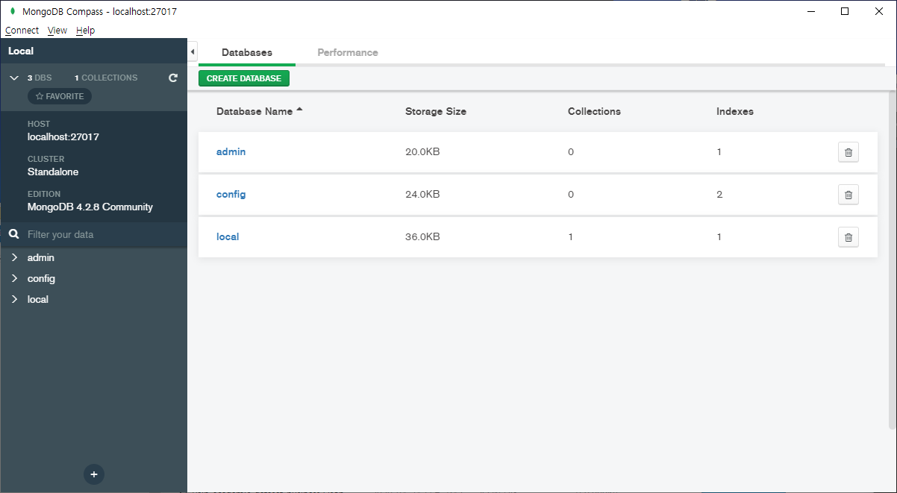
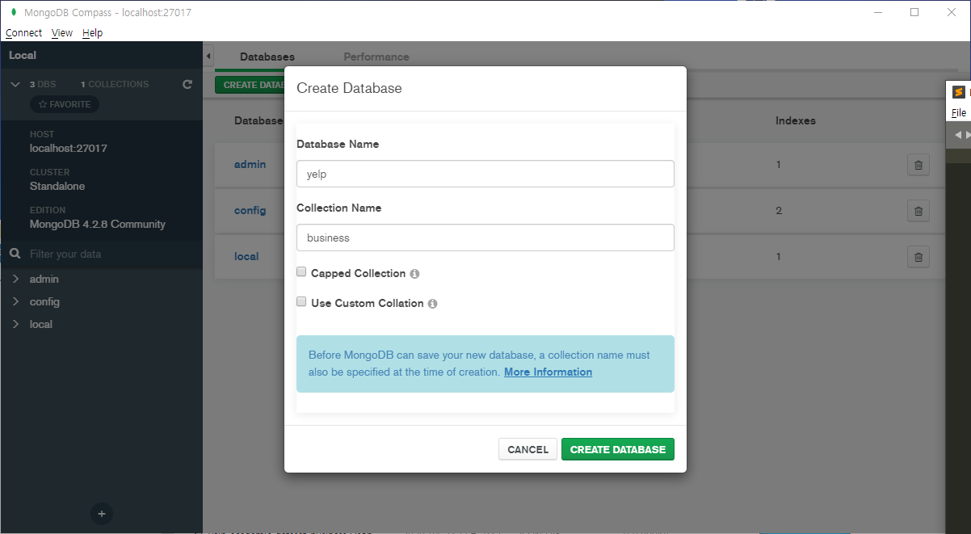
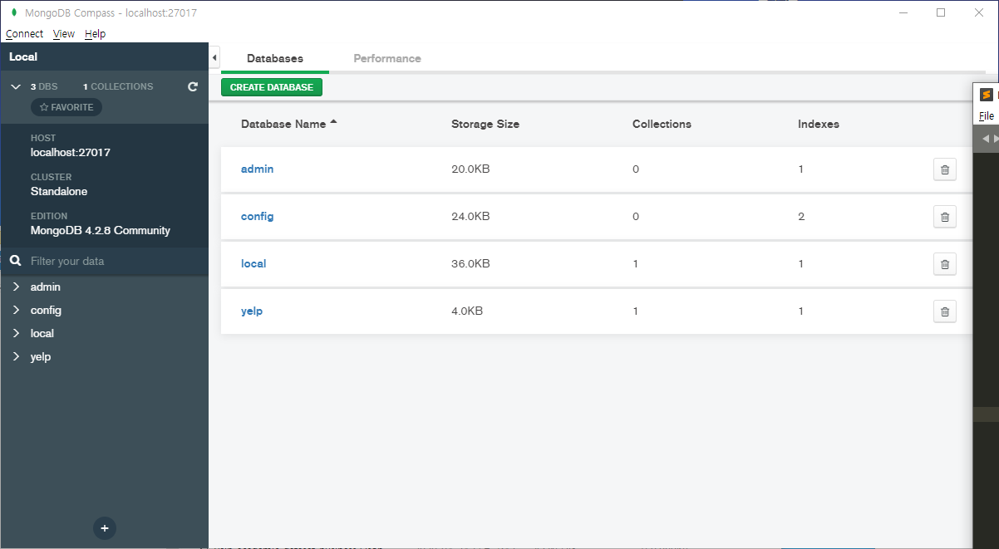
2. MongoDB 가이드
yelp DB와 business collection을 생성한다.
1. CREATE DATABASE 버튼을 누른다.
2. DATABASE 이름(yelp)과 Collection 이름(business)를
입력/생성한다.
3. yelp DB가 생성되었음을 확인할 수 있다.

Slide 20
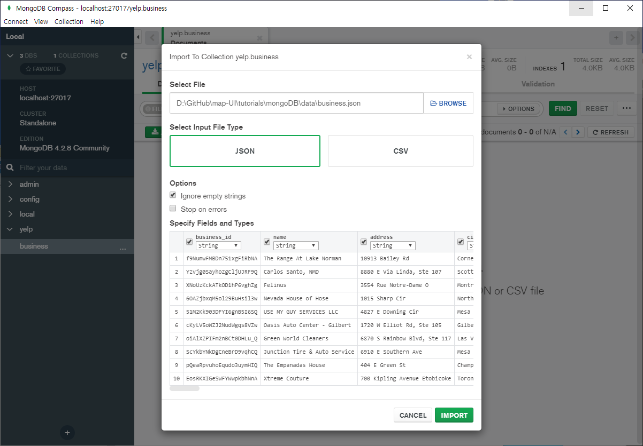
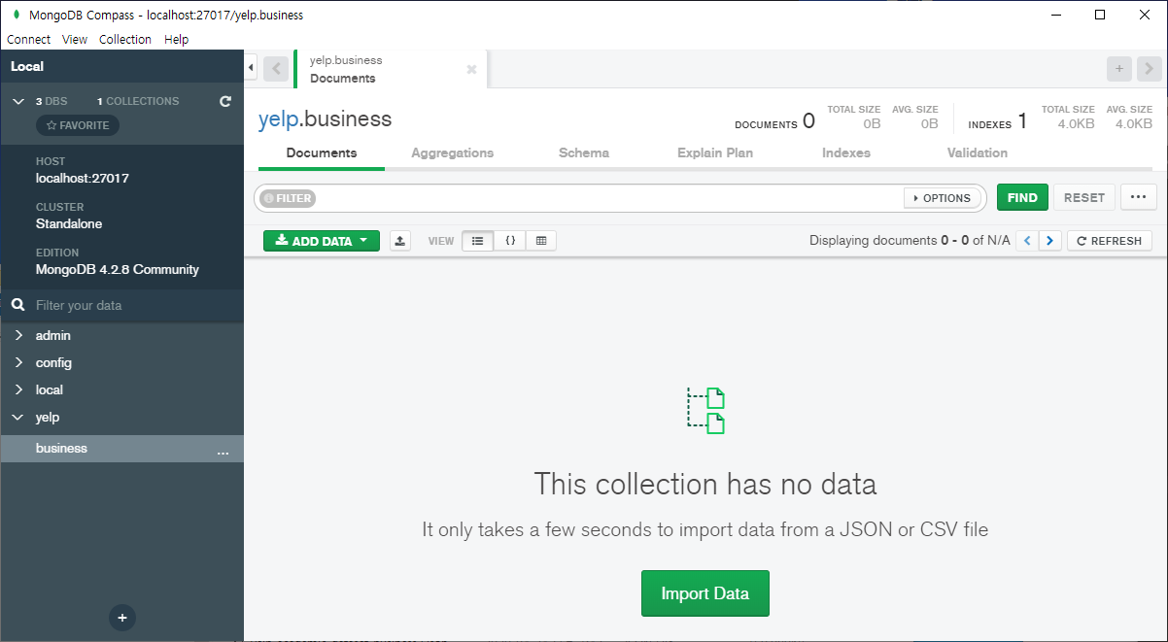
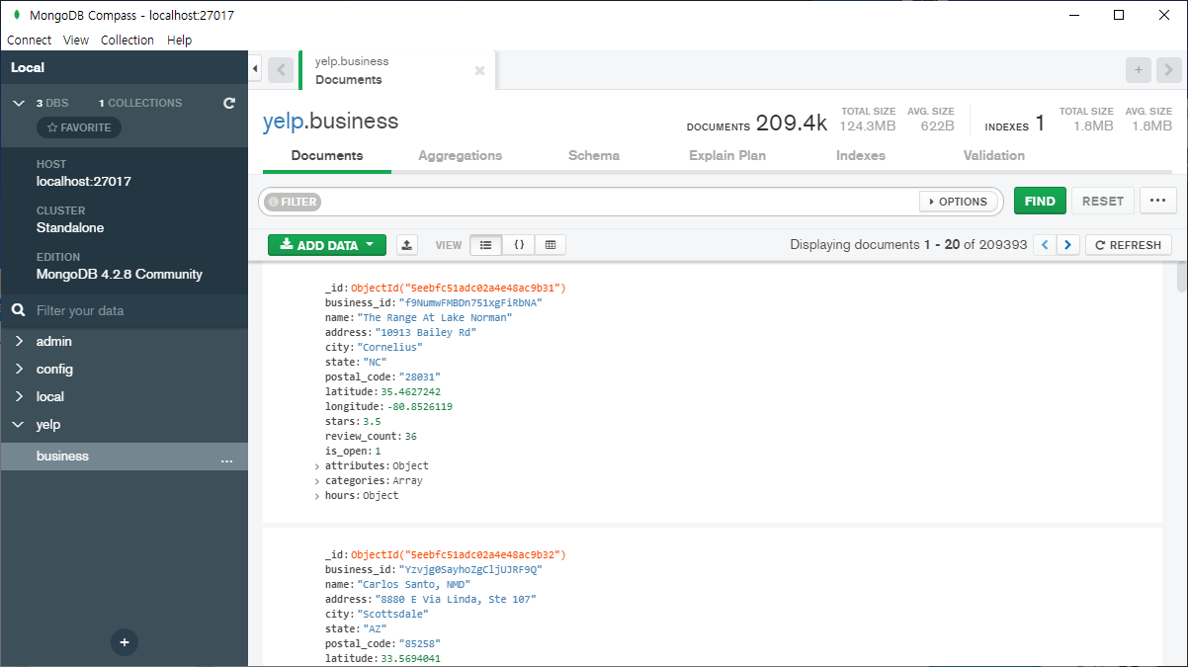
2. MongoDB 가이드
business collection에 business.json을 로드한다.
2. json 파일을 선택하고, IMPORT 버튼을 누른다.
3. business.json을 로드한 결과
1. Import Data 버튼을 누른다.

Slide 21
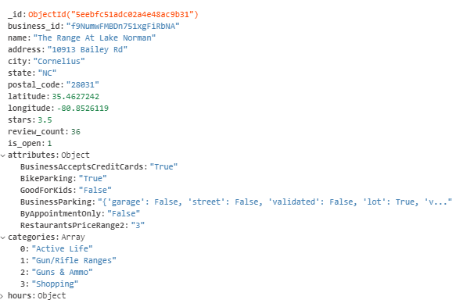
2. MongoDB 가이드
business collection

Slide 22
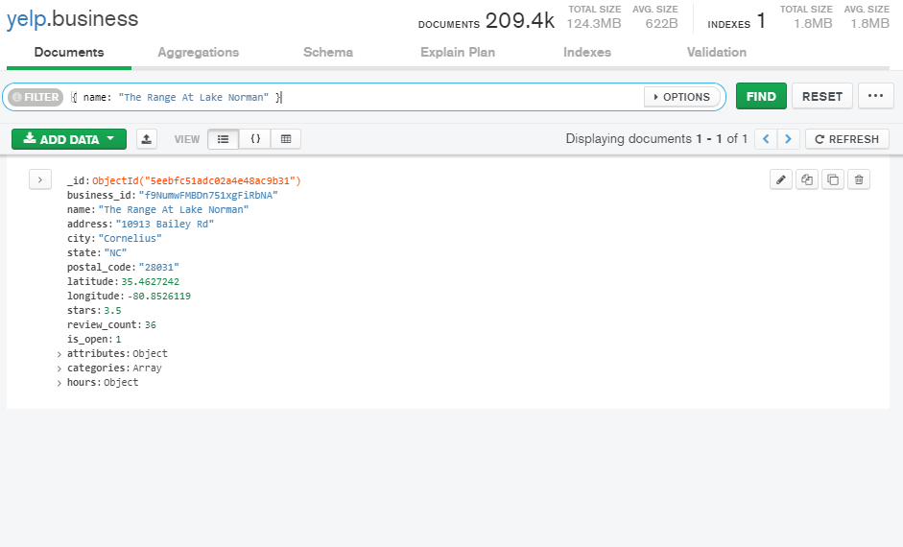
2. MongoDB 가이드
business collection 검색하기

Slide 23
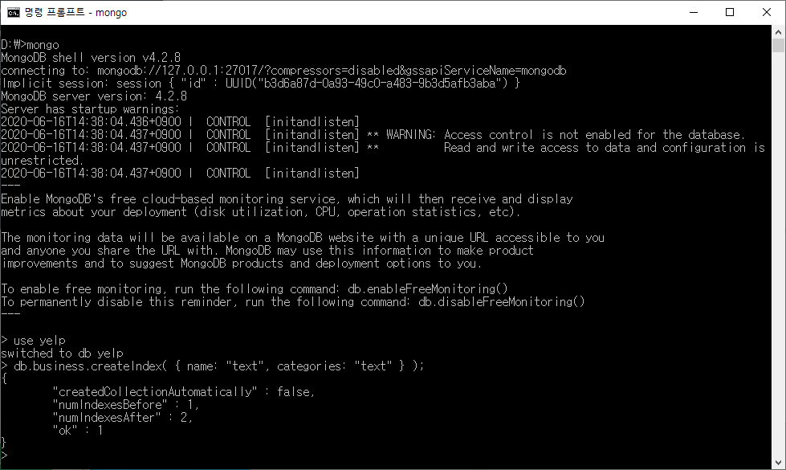
2. MongoDB 가이드
Text search (https://docs.mongodb.com/manual/text-search/)
- text index를 생성한다.
db.business.createIndex( { name: "text", categories: "text" } );

Slide 24
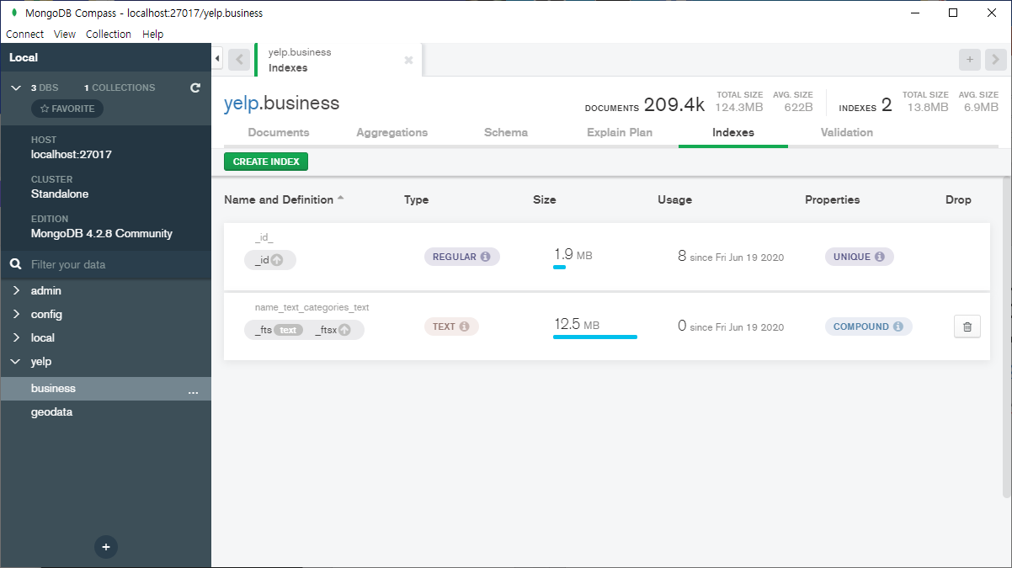
2. MongoDB 가이드
Text search (https://docs.mongodb.com/manual/text-search/)
- text index를 생성한다.
db.business.createIndex( { name: "text", categories: "text" } );
TEXT Type의 인덱스가
만들어졌다.

Slide 25

2. MongoDB 가이드
Text search (https://docs.mongodb.com/manual/text-search/)
- text index를 생성한다.
- text index를 사용하여 검색한다.
db.business.createIndex( { name: "text", categories: "text" } );
db.business.find( { $text : { $search : "Norman" } } );

Slide 26
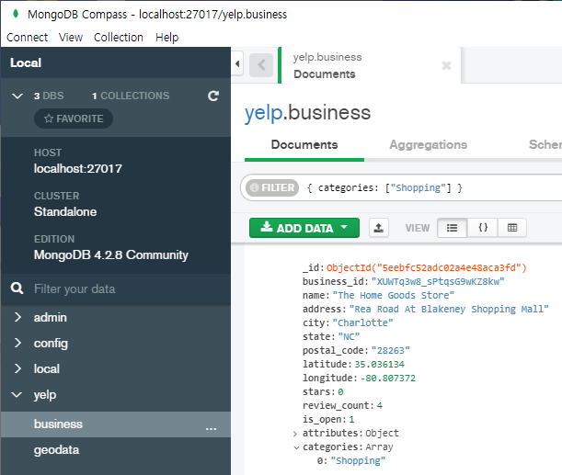
2. MongoDB 가이드
Query an Array (https://docs.mongodb.com/manual/tutorial/query-arrays/)
db.business.find({ categories: ["Shopping"] });

Slide 27
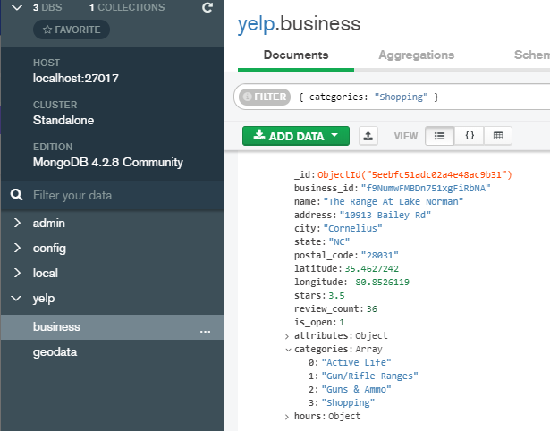
2. MongoDB 가이드
Query an Array (https://docs.mongodb.com/manual/tutorial/query-arrays/)
db.business.find({ categories: "Shopping" } );

Slide 28
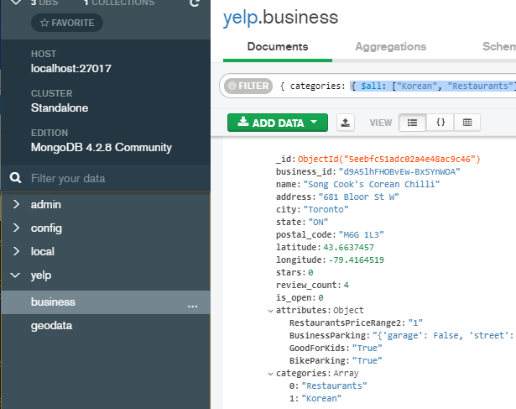
2. MongoDB 가이드
Query an Array (https://docs.mongodb.com/manual/tutorial/query-arrays/)
db.business.find({ categories: { $all: ["Korean", "Restaurants"] } });

Slide 29
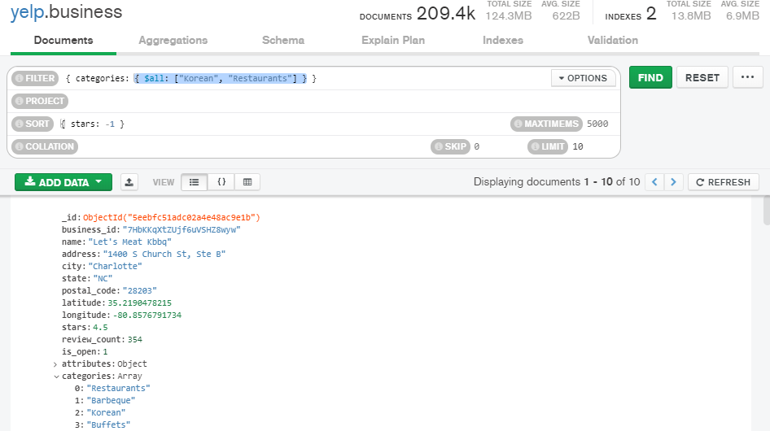
2. MongoDB 가이드
Query an Array (https://docs.mongodb.com/manual/tutorial/query-arrays/)
db.business.find({ categories: { $all: ["Korean", "Restaurants"] } }).sort( { stars: -1 } ).limit(10);

Slide 30
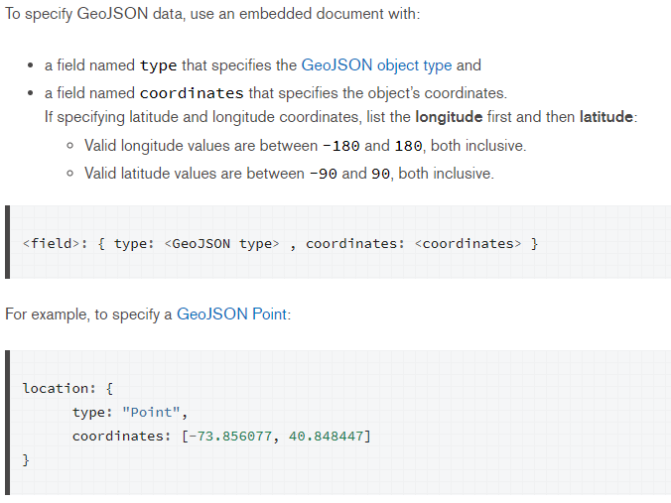
2. MongoDB 가이드
위치 기반 검색(https://docs.mongodb.com/manual/geospatial-queries/)

Slide 31
2. MongoDB 가이드
geodata collection 만들기
db.business.find().forEach(function(biz){
db.geodata.insert({ "geometry": { "type": "Point", "coordinates": [ biz.longitude, biz.latitude ] },
"properties": { "business_id": biz.business_id,
"name": biz.name,
"stars": biz.stars,
"review_count": biz.review_count,
"categories": biz.categories } });
});

Slide 32
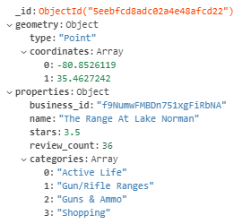
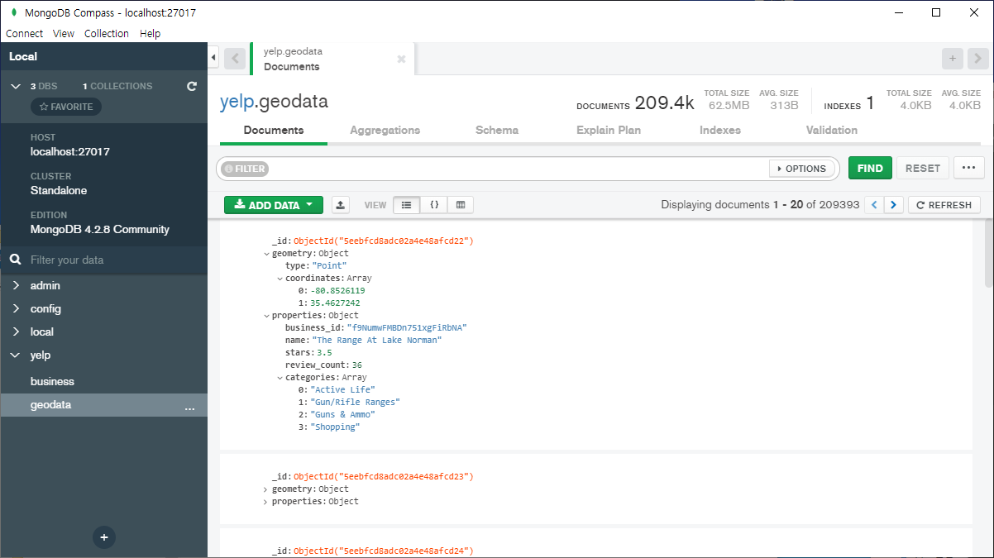
2. MongoDB 가이드
geodata collection 만들기

Slide 33
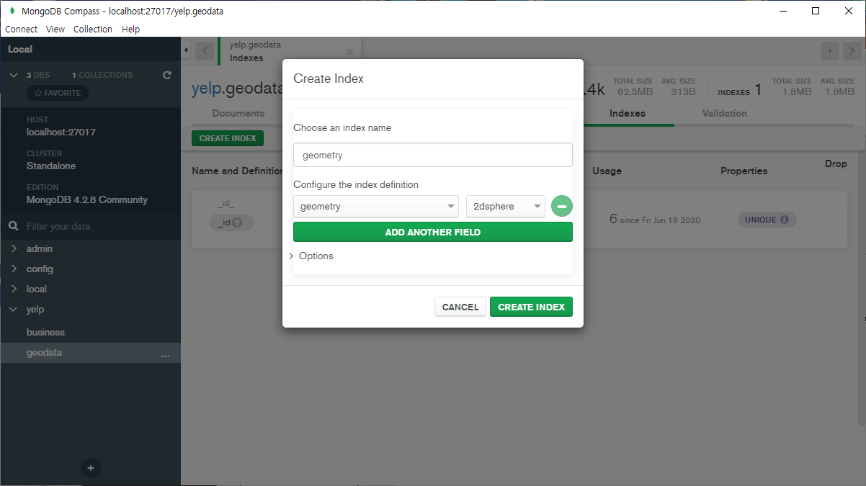
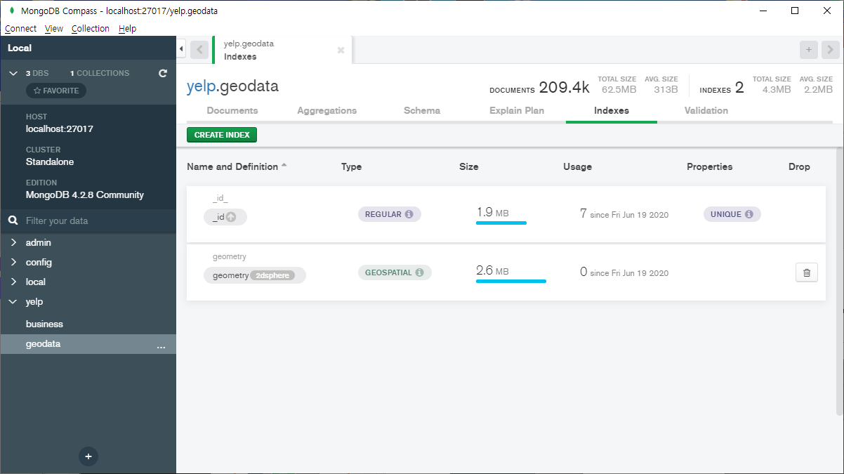
2. MongoDB 가이드
2dsphere 인덱스 생성하기

Slide 34

2. MongoDB 가이드
위치 기반 검색(https://docs.mongodb.com/manual/geospatial-queries/)
db.geodata.find({ geometry: { $geoWithin: { $box: [[ -80.5, 35],[ -80., 35.5]]}}});

Slide 35
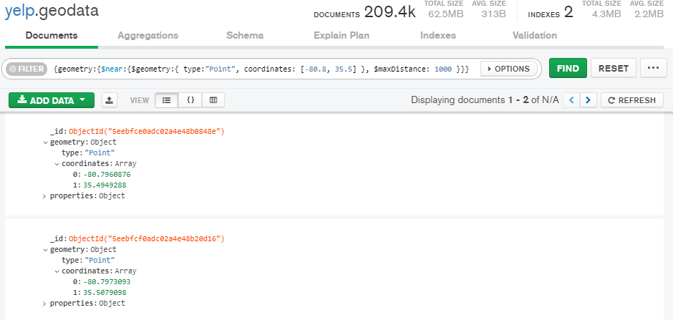
2. MongoDB 가이드
위치 기반 검색(https://docs.mongodb.com/manual/geospatial-queries/)
db.geodata.find({ geometry: { $near: { $geometry: { type: "Point", coordinates: [-80.8, 35.5] },
$minDistance: 0, $maxDistance: 1000 }}});

Slide 36
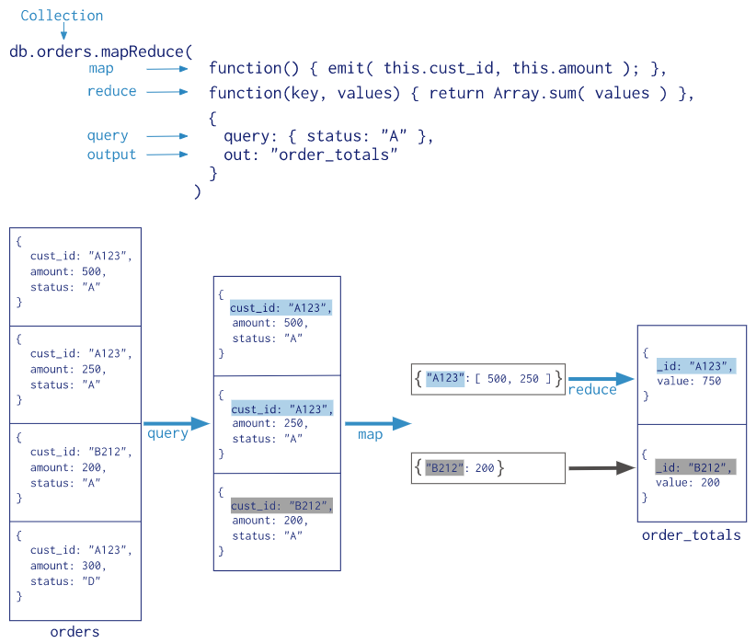
2. MongoDB 가이드
CRUD Operations (https://docs.mongodb.com/manual/crud/)
Query Operators (https://docs.mongodb.com/manual/reference/operator/query/)
Aggregation (https://docs.mongodb.com/manual/aggregation/)
db.orders.aggregate([
{ $match: { status: "A" } },
{ $group: { _id: "$cust_id", total: { $sum: "$amount" } } }
])

Slide 37
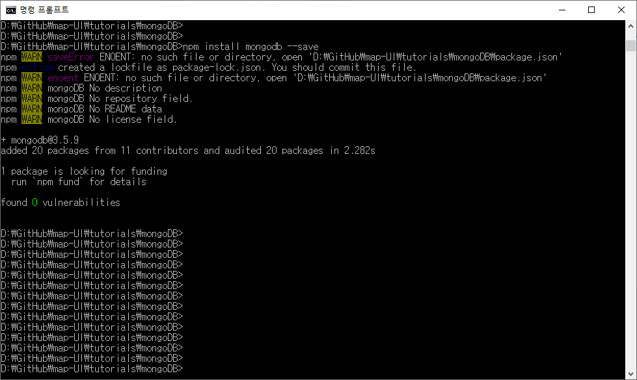
3. MongoDB + Node.js 가이드
MongoDB + Node.js 가이드
(http://mongodb.github.io/node-mongodb-native/3.4/quick-start/quick-start/)
D:\> npm install mongodb --save
package-lock.json
파일이 생성됨.

Slide 38
3. MongoDB + Node.js 가이드
간단한 Query(tutorials/mongoDB/db1.js)
const MongoClient = require('mongodb').MongoClient;
const url = 'mongodb://localhost:27017';
const client = new MongoClient(url);
client.connect(function(err) {
console.log("Connected successfully to server");
const db = client.db('yelp');
const collection = db.collection('business');
collection.find({ categories: { $all: ["Korean", "Restaurants"] } }).sort({ stars: -1 }).limit(5).toArray(function(err, docs){
console.log("Found the following records");
console.log(docs);
client.close();
});
});

Slide 39
3. MongoDB + Node.js 가이드
간단한 Query(tutorials/mongoDB/db2.js)
const MongoClient = require('mongodb').MongoClient;
const url = 'mongodb://localhost:27017';
const client = new MongoClient(url);
client.connect(function(err) {
console.log("Connected successfully to server");
const db = client.db('yelp');
const collection = db.collection('geodata');
collection.find({ geometry: { $near: { $geometry: { type: "Point", coordinates: [-80.8, 35.5] },
$minDistance: 0, $maxDistance: 1000 }}}).toArray(function(err, docs){
console.log("Found the following records");
console.log(docs);
client.close();
});
});

Slide 40
3. MongoDB + Node.js 가이드
Node.js web server(tutorials/mongoDB/web.js)
var http = require('http')
var app = http.createServer(function(request, response){
response.writeHead(200, { 'Content-Type': 'text/plain' })
response.write('Hello World!!!')
response.end()
})
app.listen(8080)

Slide 41
3. MongoDB + Node.js 가이드
Node.js web server(tutorials/mongoDB/db3.js)
const MongoClient = require('mongodb').MongoClient
const client = new MongoClient('mongodb://localhost:27017')
client.connect(function(err) {
console.log("Connected successfully to DB server")
const db = client.db('yelp')
const collection = db.collection('geodata')
require('http').createServer(function(request, response){
collection.find({ geometry: { $near: { $geometry: { type: 'Point', coordinates: [-80.8, 35.5] },
$minDistance: 0, $maxDistance: 1000 }}}).toArray(function(err, docs){
response.writeHead(200, { 'Content-Type': 'text/plain' })
response.write(JSON.stringify(docs))
response.end()
});
}).listen(8080)
});

Slide 42
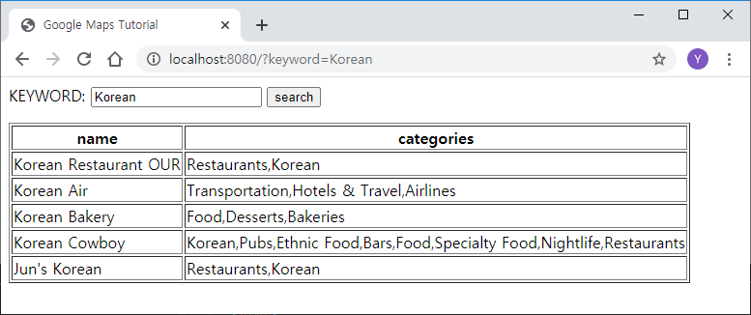
3. MongoDB + Node.js 가이드
Node.js web server(tutorials/mongoDB/index.html)
<html>
<head>
<title>Google Maps Tutorial</title>
</head>
<body>
<form action="/">
KEYWORD: <input type="text" name="keyword" />
<input type="submit" value="search" />
</form>
<table border=1>
<thead><tr><th>name</th><th>categories</th></tr></thead>
<tr><td>Korean Restaurant OUR</td><td>Restaurants,Korean</td></tr>
<tr><td>Korean Air</td><td>Transportation,Hotels & Travel,Airlines</td></tr>
<tr><td>Korean Bakery</td><td>Food,Desserts,Bakeries</td></tr>
<tr><td>Korean Cowboy</td><td>Korean,Pubs,Ethnic Food,Bars,Food,Specialty Food,Nightlife,Restaurants</td></tr>
<tr><td>Jun's Korean</td><td>Restaurants,Korean</td></tr>
</table>
</body>
</html>

Slide 43
3. MongoDB + Node.js 가이드
Node.js web server(tutorials/mongoDB/db4.js)
const MongoClient = require('mongodb').MongoClient
const client = new MongoClient('mongodb://localhost:27017’)
client.connect(function(err) {
const db = client.db('yelp')
const collection = db.collection('geodata')
require('http').createServer(function(request, response){
var url = request.url
if(url == '/favicon.ico'){
return response.writeHead(404);
}
response.writeHead(200, { 'Content-Type': 'text/html' })
response.write(' \
<html> \
<head><title>Google Maps Tutorial</title></head> \
<body> \
<form action="/"> \
KEYWORD: <input type="text" name="keyword"> \
<input type="submit" value="search" /> \
</form> \
')
db.geodata.createIndex( { "properties.name": "text", "properties.category": "text" } ) // text index를 생성함.

Slide 44
3. MongoDB + Node.js 가이드
Node.js web server(tutorials/mongoDB/db4.js)
// /?keyword=KEYWORD
var n = url.indexOf('?');
var keyword = (n < 0) ? '' : url.substr(n + 9)
console.log(keyword)
if (keyword != ''){
collection.find({ $text: { $search: keyword }}).limit(5).toArray(function(err, docs){
response.write('<table border=1>')
response.write('<thead><tr><th>name</th><th>categories</th></tr></thead>')
for(var i = 0; i < docs.length; i++){
response.write('<tr><td>' + docs[i].properties.name + '</td>')
response.write('<td>' + docs[i].properties.categories + '</td></tr>')
}
response.write('</table></body></html>')
response.end()
})
}
else {
response.write('</body></html>')
response.end()
}
}).listen(8080)
})
db.geodata.createIndex( { "properties.name": "text", "properties.category": "text" } ) // text index를 생성함.

Slide 45
4. Express.js + Mongoose
Express.js : 빠르고 개방적인 간결한 웹 프레임워크 (https://expressjs.com)
$ npm install express --save
const express = require('express')
const app = express()
const port = 3000
app.get('/', (req, res) => res.send('Hello World!'))
app.listen(port, () => console.log(`Example app listening at http://localhost:${port}`))

Slide 46
4. Express.js + Mongoose
Express.js : 빠르고 개방적인 간결한 웹 프레임워크 (https://expressjs.com)
라우팅 (https://expressjs.com/ko/guide/routing.html)
const express = require('express')
const app = express()
const port = 3000
app.get('/', (req, res) => res.send('Main Page!’))
app.get('/search', (req, res) => res.send('Search page!!!'))
app.post('/search', (req, res) => res.send('Search result page!!!'))
app.listen(port, () => console.log(`Example app listening at http://localhost:${port}`))

Slide 47
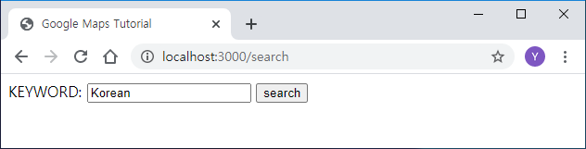
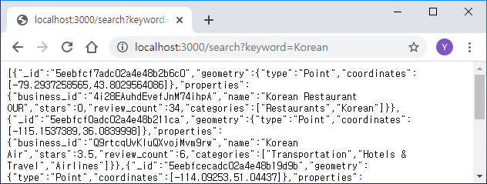
4. Express.js + Mongoose
Express.js : 빠르고 개방적인 간결한 웹 프레임워크 (https://expressjs.com)
라우팅 (https://expressjs.com/ko/guide/routing.html)
Express.js server(tutorials/express/db5.js)
const express = require('express')
const app = express()
const port = 3000
app.get('/search', function(request, response){
const keyword = request.query.keyword
console.log(keyword)
if (keyword == undefined){
response.sendFile(__dirname + '/search.html')
}
else {
collection.find({ $text: { $search: keyword }})
.limit(5).toArray(function(err, docs){
response.json(docs)
})
}
})

Slide 48
4. Express.js + Mongoose
Express.js : 빠르고 개방적인 간결한 웹 프레임워크 (https://expressjs.com)
라우팅 (https://expressjs.com/ko/guide/routing.html)
라우터 모듈
const express = require('express')
const app = express()
const port = 3000
app.get('/', (req, res) => res.send('Birds home page!’))
var birds = require('./birds')
app.use('/birds', birds)
app.listen(port)
./birds.js
var express = require('express');
var router = express.Router();
// define the home page route
router.get('/', function(req, res) {
res.send('Birds home page');
});
// define the about route
router.get('/about', function(req, res) {
res.send('About birds');
});
module.exports = router;

Slide 49
4. Express.js + Mongoose
mongoose : elegant MongoDB object modeling (https://mongoosejs.com/)
(tutorials/express/mongoose1.js)
const mongoose = require('mongoose');
mongoose.connect('mongodb://localhost/test', {useNewUrlParser: true, useUnifiedTopology: true});
// 1) defining schema
const userSchema = new mongoose.Schema({
name: String, age: Number,
});
// 2) creating model (collection)
const User = mongoose.model('users', userSchema);
// 3) instantiating document
const kim = new User({ name: 'Kim', age: 45 });
console.log(kim); // 'Silence’
// 4) updating document
kim.save();

Slide 50
4. Express.js + Mongoose
mongoose : elegant MongoDB object modeling (https://mongoosejs.com/)
(tutorials/express/mongoose2.js)
const mongoose = require('mongoose');
mongoose.connect('mongodb://localhost/test', {useNewUrlParser: true, useUnifiedTopology: true});
// 1) defining schema
const userSchema = new mongoose.Schema({
name: String, age: Number,
});
// 2) creating model (collection)
const User = mongoose.model('users', userSchema);
// 3) finding document
const query = User.find().where('age').gt(40).lt(60);
query.exec(function(error, result){
console.log(result.length); // result is array
result.forEach(function(user){
console.log(user.name + '(' + user.age + ')');
});
});

Slide 51
4. Express.js + Mongoose
mongoose : elegant MongoDB object modeling (https://mongoosejs.com/)
(tutorials/express/mongoose3.js)
const mongoose = require('mongoose');
mongoose.connect('mongodb://localhost/test', {useNewUrlParser: true, useUnifiedTopology: true});
// 1) defining schema
const userSchema = new mongoose.Schema({
name: String, age: Number,
});
// 1-A) adding static
userSchema.statics.findByName = function(name){
return this.find({name: name});
};
// 1-B) adding instance method
userSchema.methods.print = function(){
console.log(this.name + '(' + this.age + ')');
};
// 1-C) adding query helper
userSchema.query.byName = function(name){
return this.where({name: name});
};
// NOTE: they must be added to the schema before compiling it with mongoose.model()
// 2) creating model (collection)
const User = mongoose.model('users', userSchema);
// 3) finding document
User.findByName('Kim').exec(function(error, result){
result.forEach(function(user){
user.print();
})
})
User.find().byName('Kim').exec(function(error, result){
result.forEach(function(user){
user.print();
})
})

Slide 52
4. Express.js + Mongoose
mongoose : elegant MongoDB object modeling (https://mongoosejs.com/)
(tutorials/express/mongoose4.js, models/user.js)
mongoose4.js
models/user.js
const mongoose = require('mongoose');
mongoose.connect('mongodb://localhost/test’,
{useNewUrlParser: true, useUnifiedTopology: true});
const User = require('./models/user');
User.findByName('Kim').exec(function(error, result){
result.forEach(function(user){
user.print();
})
})
const mongoose = require('mongoose');
const userSchema = new mongoose.Schema({
name: String,
age: Number,
});
userSchema.statics.findByName = function(name){
return this.find({name: name});
};
userSchema.methods.print = function(){
console.log(this.name + '(' + this.age + ')');
};
userSchema.query.byName = function(name){
return this.where({name: name});
};
module.exports = mongoose.model('users', userSchema);

Slide 53
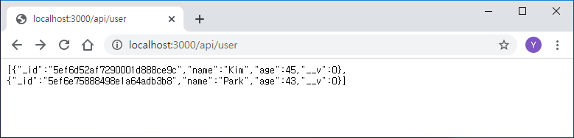
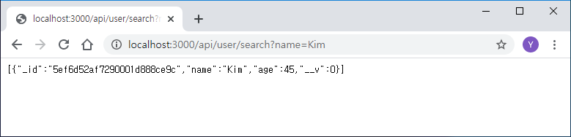
4. Express.js + Mongoose
mongoose : elegant MongoDB object modeling (https://mongoosejs.com/)
(tutorials/express/mongoose5.js, models/user.js, api/user.js)
GET: /api/user
GET: /api/user/search?name=NAME

Slide 54
4. Express.js + Mongoose
mongoose : elegant MongoDB object modeling (https://mongoosejs.com/)
(tutorials/express/mongoose5.js, models/user.js, api/user.js)
mongoose5.js
api/user.js
const mongoose = require('mongoose');
mongoose.connect('mongodb://localhost/test’,
{useNewUrlParser: true, useUnifiedTopology: true});
const express = require('express');
const app = express();
const port = 3000;
app.use('/api/user', require('./api/user'));
app.listen(port);
const express = require('express');
const router = express.Router();
const User = require('../models/user');
router.get('/', function(request, response) {
User.find(function(error, result){
if (error) return response.status(500).json(error);
return response.json(result);
});
});
router.get('/search', function(request, response) {
User.findByName(request.query.name).exec(function(error, result){
if (error) return response.status(500).json(error);
return response.json(result);
});
});
module.exports = router;

Slide 55
4. Express.js + Mongoose
Yelp Business(tutorials/express/models/business.js)
const mongoose = require('mongoose’);
const businessSchema = new mongoose.Schema({
business_id: { type: String, unique: true, index: true, required: true },
name: String,
address: String,
city: String,
state: String,
postal_code: String,
latitude: Number,
longitude: Number,
stars: Number,
review_count: Number,
is_open: Boolean,
attributes: Object,
categories: [String],
hours: {
Monday: String,
Tuesday: String,
Wednesday: String,
Thursday: String,
Friday: String,
Saturday: String,
Sunday: String,
}
},
{
collection: 'business' // collection name
}
);
businessSchema.index({name: 'text', categories: 'text'});
businessSchema.statics.findByID = function(ID){
return this.find({business_id: ID});
};
businessSchema.statics.findByKeyword = function(keyword){
return this.find({$text: {$search: keyword}});
};
module.exports = mongoose.model('business', businessSchema);

Slide 56
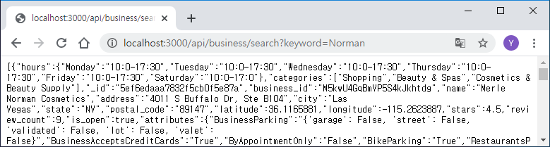
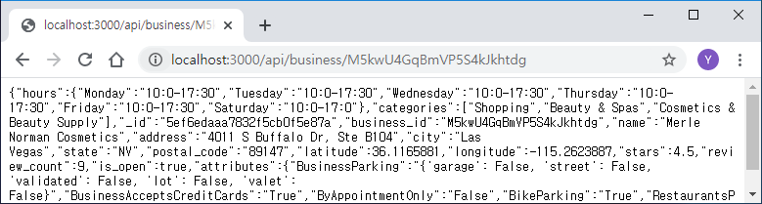
4. Express.js + Mongoose
Yelp Business(tutorials/express/api/business.js)
const express = require('express');
const router = express.Router();
const Business = require('../models/business’);
router.get('/search', function(request, response) {
Business.findByKeyword(request.query.keyword)
.sort({stars: -1}).limit(10).exec(function(error, result){
if (error) return response.status(500).json(error);
return response.json(result);
});
});
router.get('/:id', function(request, response) {
Business.findByID(request.params.id).exec(function(error, result){
if (error) return response.status(500).json(error);
return response.json(result[0]);
});
});
module.exports = router;

Slide 57
4. Express.js + Mongoose
Yelp Business(tutorials/express/models/geodata.js)
const mongoose = require('mongoose');
const geodataSchema = new mongoose.Schema({
geometry: {
type: String,
coordinates: [Number]
},
const mongoose = require('mongoose’);
const geodataSchema = new mongoose.Schema({
geometry: {
type: { type: String },
coordinates: [Number]
},
properties: {
business_id: { type: String, unique: true, index: true, required: true },
name: String,
stars: Number,
review_count: Number,
categories: [String],
}
},
{
collection: 'geodata' // collection name
}
);
mongoose.set('debug', true);

Slide 58
4. Express.js + Mongoose
Yelp Business(tutorials/express/models/geodata.js)
const mongoose = require('mongoose’);
const geodataSchema = new mongoose.Schema({
geometry: {
type: String,
coordinates: [Number]
},
const mongoose = require('mongoose’);
const geodataSchema = new mongoose.Schema({
geometry: {
type: { type: String },
coordinates: [Number]
},
properties: {
business_id: { type: String, unique: true, index: true, required: true },
name: String,
stars: Number,
review_count: Number,
categories: [String],
}
},
{
collection: 'geodata' // collection name
}
);

Slide 59
4. Express.js + Mongoose
Yelp Business(tutorials/express/models/geodata.js)
const mongoose = require('mongoose');
const pointSchema = new mongoose.Schema({
type: { type: String, enum: ['Point'], required: true },
coordinates: { type: [Number], required: true }
});
const geodataSchema = new mongoose.Schema({
geometry: pointSchema,
properties: {
business_id: { type: String, unique: true, index: true, required: true },
name: String,
stars: Number,
review_count: Number,
categories: [String],
}
},
{
collection: 'geodata' // collection name
}
);
geodataSchema.index({'properties.name': 'text', 'properties.categories': 'text'});
geodataSchema.statics.findByID = function(ID){
return this.find().where('properties.business_id', ID);
};
geodataSchema.statics.findByKeyword = function(keyword){
return this.find({$text: {$search: keyword}});
};

Slide 60
4. Express.js + Mongoose
Yelp Business(tutorials/express/models/geodata.js)
const mongoose = require('mongoose');
const pointSchema = new mongoose.Schema({
type: { type: String, enum: ['Point'], required: true },
coordinates: { type: [Number], required: true }
});
const geodataSchema = new mongoose.Schema({
geometry: pointSchema,
properties: {
business_id: { type: String, unique: true, index: true, required: true },
name: String,
stars: Number,
review_count: Number,
categories: [String],
}
},
{
collection: 'geodata' // collection name
}
);
geodataSchema.index({geometry: '2dsphere'});
geodataSchema.statics.findInBox = function(lowerLeft, upperRight){
return this.find().where('geometry').box(lowerLeft, upperRight);
};
geodataSchema.statics.findNear = function(center, maxDistance){
return this.find().where('geometry')
.near({center: center, maxDistance: maxDistance, spherical: true});
};
module.exports = mongoose.model('geodata', geodataSchema);

Slide 61
4. Express.js + Mongoose
Yelp Business(tutorials/express/api/geodata.js)
const express = require('express');
const router = express.Router();
const geodata = require('../models/geodata');
router.get('/within', function(request, response) {
geodata.findInBox([Number(request.query.left), Number(request.query.lower)],
[Number(request.query.right), Number(request.query.upper)])
.exec(function(error, result){
if (error) return response.status(500).json(error);
return response.json(result);
});
});
router.get('/near', function(request, response) {
geodata.findNear([Number(request.query.longitude), Number(request.query.latitude)],
Number(request.query.maxDistance))
.limit(10).exec(function(error, result){
if (error) return response.status(500).json(error);
return response.json(result);
});
});

Slide 62
4. Express.js + Mongoose
Yelp Business(tutorials/express/api/geodata.js)
router.get('/search', function(request, response) {
console.log(request.query.keyword);
geodata.findByKeyword(request.query.keyword)
.sort({stars: -1}).limit(10).exec(function(error, result){
if (error) return response.status(500).json(error);
return response.json(result);
});
});
router.get('/:id', function(request, response) {
geodata.findByID(request.params.id).exec(function(error, result){
if (error) return response.status(500).json(error);
return response.json(result[0]);
});
});
module.exports = router;

Slide 63
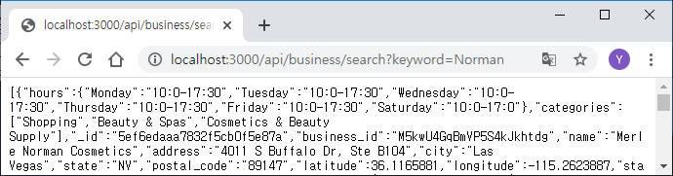
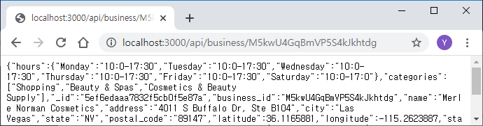
4. Express.js + Mongoose
Express.js server(tutorials/express/db6.js)
const mongoose = require('mongoose');
mongoose.connect('mongodb://localhost/yelp',
{useNewUrlParser: true, useUnifiedTopology: true, useCreateIndex: true});
mongoose.set('debug', true);
const express = require('express');
const app = express();
const port = 3000;
app.use('/api/business', require('./api/business'));
app.use('/api/geodata', require('./api/geodata'));
app.listen(port);

Slide 64
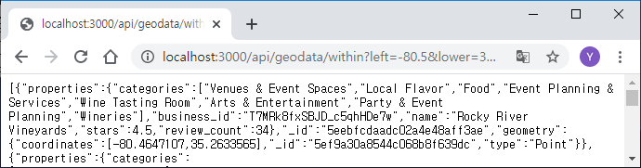
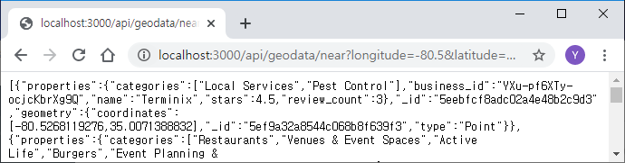
4. Express.js + Mongoose
Express.js server(tutorials/express/db6.js)
const mongoose = require('mongoose');
mongoose.connect('mongodb://localhost/yelp',
{useNewUrlParser: true, useUnifiedTopology: true, useCreateIndex: true});
mongoose.set('debug', true);
const express = require('express');
const app = express();
const port = 3000;
app.use('/api/business', require('./api/business'));
app.use('/api/geodata', require('./api/geodata'));
app.listen(port);

Slide 65
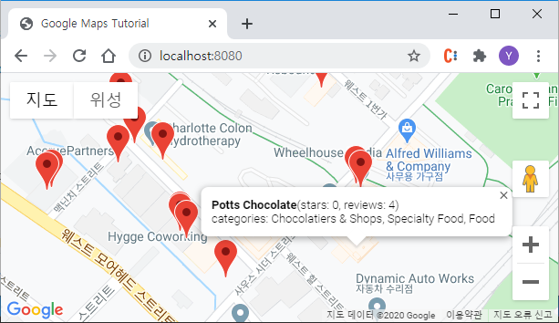
4. Express.js + Mongoose
Integrating Maps with Mongo DB(tutorials/express/index.html)
http://localhost:8080
http_server
index.html
http://localhost:3000/api/geodata/within?left=...
<<express>>
node db6.js
MongoDB
XMLHttpRequest
(Ajax, Asynchronous JavaScript and XML)
GeoJson data
https://ko.wikipedia.org/wiki/Ajax

Slide 66
4. Express.js + Mongoose
Integrating Maps with Mongo DB(tutorials/express/index.html)
<!DOCTYPE html>
<html>
<head>
<title>Google Maps Tutorial</title>
<style type="text/css">
#map {
height: 100%;
}
html,
body {
height: 100%;
margin: 0;
padding: 0;
}
</style>
<script>
function initMap() {
var options = {
center: { lat: 35.25, lng: -80.85 },
zoom: 16,
};
var map = new google.maps.Map(document.getElementById('map'), options);

Slide 67
4. Express.js + Mongoose
Integrating Maps with Mongo DB(tutorials/express/index.html)
map.addListener('idle', function(){
// remove all
map.data.forEach(function(feature){ map.data.remove(feature); });
const bounds = map.getBounds();
const sw = bounds.getSouthWest();
const ne = bounds.getNorthEast();
const request = new XMLHttpRequest();
const url = 'http://localhost:3000/api/geodata/within?' + 'left=' + sw.lng() + '&lower=' + sw.lat()
+ '&right=' + ne.lng() + '&upper=' + ne.lat();
request.open('GET', url);
request.responseType = 'json';
request.send();
request.onload = function() {
const geodata = request.response;
for(var i = 0; i < geodata.length; i++){
const latLng = new google.maps.LatLng({ lng: geodata[i].geometry.coordinates[0],
lat: geodata[i].geometry.coordinates[1] });
map.data.add(new google.maps.Data.Feature({ geometry: latLng, properties: geodata[i].properties } ));
}
}
});

Slide 68
4. Express.js + Mongoose
Integrating Maps with Mongo DB(tutorials/express/index.html)
const infowindow = new google.maps.InfoWindow();
map.data.addListener('click', function(e){
const feature = e.feature;
const name = feature.getProperty("name");
const stars = feature.getProperty("stars");
const review_count = feature.getProperty("review_count");
const categories = feature.getProperty("categories");
let content = '<div><b>' + name + '</b>(stars: ' + stars + ', reviews: ' + review_count + ')<br>categories: ';
content += categories[0];
for(var i = 1; i < categories.length; i ++)
content += ', ' + categories[i];
content += '</div>';
infowindow.setPosition(e.latLng);
infowindow.setContent(content);
infowindow.open(map);
});
}
</script>
<script async defer
src="https://maps.googleapis.com/maps/api/js?key=YOUR_KEY&callback=initMap&libraries=geometry">
</script>
</head>
<body>
<div id="map"></div>
</body>
</html>

Slide 69
4. Express.js + Mongoose
Integrating Maps with Mongo DB(tutorials/express/index.html)
Ajax에서 교차 출처 리소스 공유(Cross-origin Resource Sharing, CORS)는 허용되지 않는다.
http://localhost:8080
http_server
index.html
http://localhost:3000/api/geodata/within?left=...
<<express>>
node db6.js
MongoDB
GeoJson data
https://ko.wikipedia.org/wiki/교차_출처_리소스_공유

Slide 70
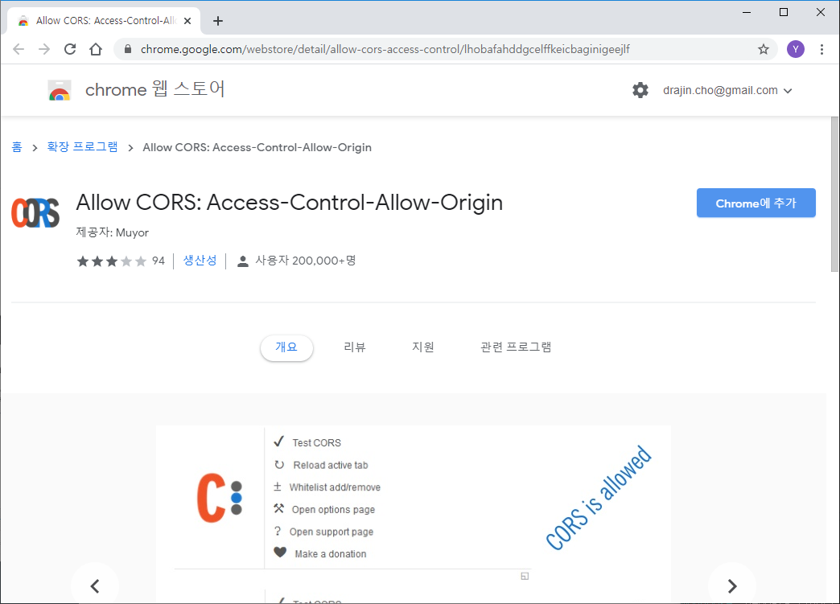
4. Express.js + Mongoose
Integrating Maps with Mongo DB(tutorials/express/index.html)
Ajax에서 교차 출처 리소스 공유(Cross-origin Resource Sharing, CORS)는 허용되지 않는다. ➔ Chrome Plugins
Enable CORS
https://ko.wikipedia.org/wiki/교차_출처_리소스_공유

Slide 71

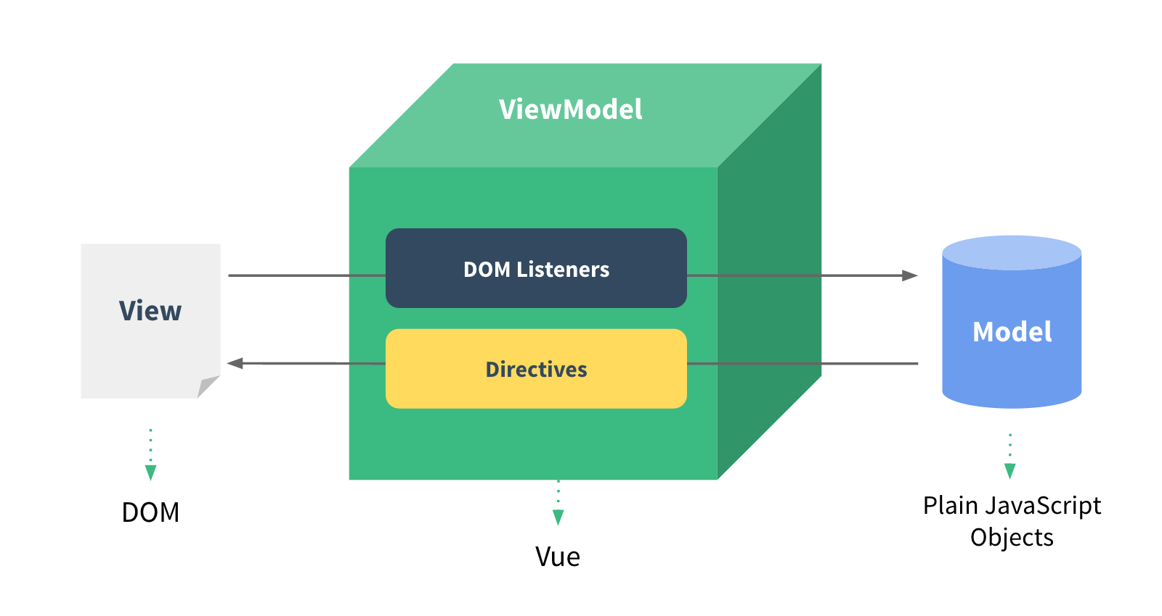
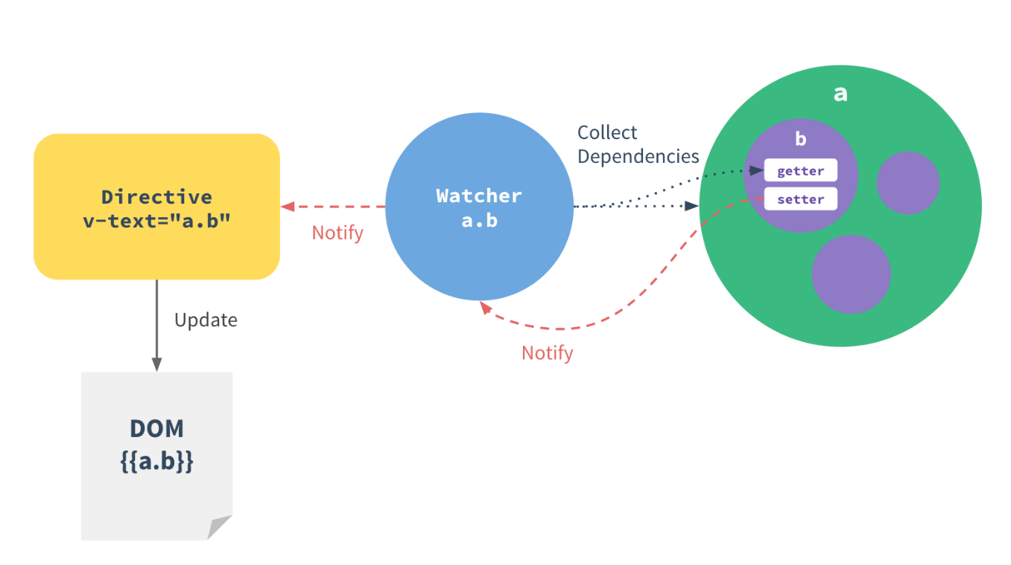
5. Vue.js
https://vuejs.org/
Vue.js is a library for building interactive web interfaces.
Vue.js is focused on the View Model layer of the MVVM pattern.
https://012.vuejs.org/guide/

Slide 72
5. Vue.js
https://vuejs.org/
Hello World (tutorials/vue/index1.html)
<!DOCTYPE html>
<html>
<head>
<script src="https://cdn.jsdelivr.net/npm/vue/dist/vue.js"></script>
<title>Vue.js Tutorial</title>
</head>
<body>
<div id="app">
{{ message }}
</div>
<script>
var app = new Vue({
el: '#app',
data: {
message: 'Hello, Vue!'
}
})
</script>
</body>
</html>
<html>
<head>
<title>Vue.js Tutorial</title>
</head>
<body>
<div id="app">
Hello, Vue!
</div>
</body>
</html>

Slide 73
5. Vue.js
https://vuejs.org/
Hello World (tutorials/vue/index2.html)
<html>
<head>
<script src="https://cdn.jsdelivr.net/npm/vue/dist/vue.js"></script>
<title>Vue.js Tutorial</title>
</head>
<body>
<div id="app">
<ol>
<li v-for="todo in todos"> {{ todo.text }} </li>
</ol>
</div>
<script>
var app = new Vue({
el: '#app',
data: {
todos: [
{ text: 'JavaScript 배우기' },
{ text: 'Vue 배우기' },
{ text: '무언가 멋진 것을 만들기' }
]
}
})
</script>
</body>
</html>
<html>
<head>
<title>Vue.js Tutorial</title>
</head>
<body>
<div id="app">
<ol>
<li> JavaScript 배우기 </li>
<li> Vue 배우기 </li>
<li> 무언가 멋진 것을 만들기 </li>
</ol>
</div>
</body>
</html>

Slide 74
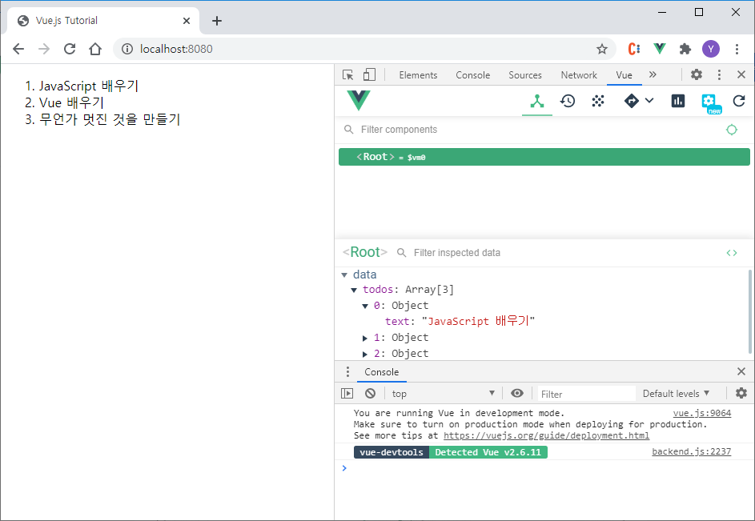
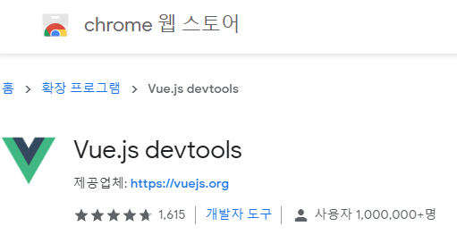
5. Vue.js
https://vuejs.org/
Vue.js devtools
Chrome 개발자 도구에 Vue 탭이 추가된다.

Slide 75
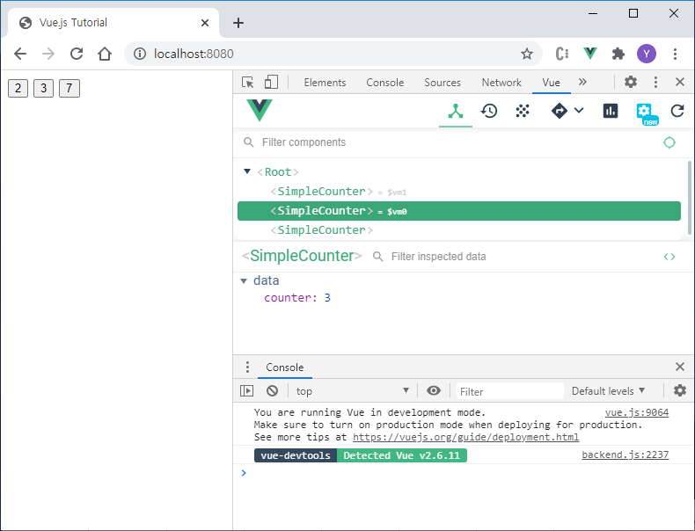
5. Vue.js
https://vuejs.org/
https://kr.vuejs.org/v2/guide/components.html
Vue Component (tutorials/vue/index3.html)
<html>
<head>
<script src="https://cdn.jsdelivr.net/npm/vue/dist/vue.js"></script>
<title>Vue.js Tutorial</title>
</head>
<body>
<div id="app">
<simple-counter></simple-counter>
<simple-counter></simple-counter>
<simple-counter></simple-counter>
</div>
<script>
Vue.component('simple-counter', {
template: '<button v-on:click="counter += 1">{{ counter }}</button>',
data: function() {
return { counter: 0 }
},
})
var app = new Vue({ el: '#app' })
</script>
</body>
</html>

Slide 76
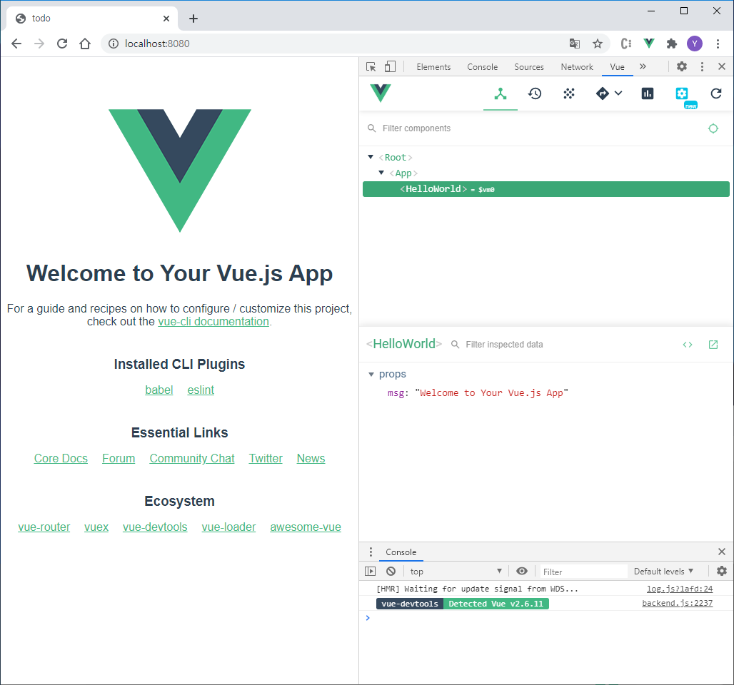
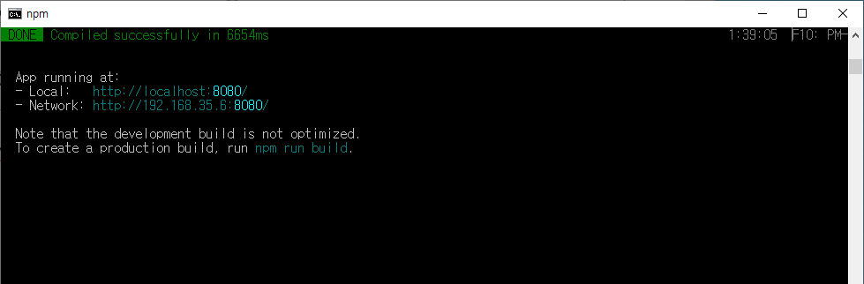
5. Vue.js
https://vuejs.org/
Vue CLI – standard tool for Vue.js Development
https://cli.vuejs.org/
C:\> npm install @vue/cli –g
C:\> vue create todo
C:\> cd todo
C:\todo> npm run serve

Slide 77
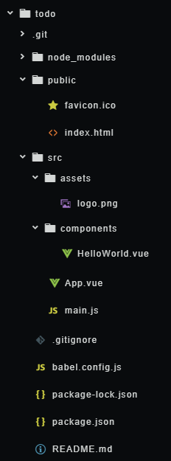
5. Vue.js
https://vuejs.org/
Vue CLI – standard tool for Vue.js Development
https://cli.vuejs.org/
{
"name": "todo",
"version": "0.1.0",
"private": true,
"scripts": {
"serve": "vue-cli-service serve",
"build": "vue-cli-service build",
"lint": "vue-cli-service lint"
},
"dependencies": {
"core-js": "^3.6.5",
"vue": "^2.6.11"
},
"devDependencies": {
"@vue/cli-plugin-babel": "~4.4.0",
"@vue/cli-plugin-eslint": "~4.4.0",
"@vue/cli-service": "~4.4.0",
"babel-eslint": "^10.1.0",
"eslint": "^6.7.2",
"eslint-plugin-vue": "^6.2.2",
"vue-template-compiler": "^2.6.11"
},
"eslintConfig": { … },
"browserslist": [ "> 1%", "last 2 versions", "not dead" ]
}
Package에 대한 정의

Slide 78
5. Vue.js
https://vuejs.org/
Vue CLI – standard tool for Vue.js Development
https://cli.vuejs.org/
<!DOCTYPE html>
<html lang="en">
<head>
<meta charset="utf-8">
<meta http-equiv="X-UA-Compatible" content="IE=edge">
<meta name="viewport" content="width=device-width,initial-scale=1.0">
<link rel="icon" href="<%= BASE_URL %>favicon.ico">
<title><%= htmlWebpackPlugin.options.title %></title>
</head>
<body>
<div id="app"></div>
<!-- built files will be auto injected -->
</body>
</html>
index.html

Slide 79
5. Vue.js
https://vuejs.org/
Vue CLI – standard tool for Vue.js Development
https://cli.vuejs.org/
<!DOCTYPE html>
<html lang="en">
<head>
<meta charset="utf-8">
<meta http-equiv="X-UA-Compatible" content="IE=edge">
<meta name="viewport" content="width=device-width,initial-scale=1.0">
<link rel="icon" href="<%= BASE_URL %>favicon.ico">
<title><%= htmlWebpackPlugin.options.title %></title>
</head>
<body>
<div id="app"></div>
<!-- built files will be auto injected -->
</body>
</html>
index.html
<!DOCTYPE html>
<html lang="en">
<head>
<meta charset="utf-8">
<meta http-equiv="X-UA-Compatible" content="IE=edge">
<meta name="viewport" content="width=device-width,initial-scale=1.0">
<link rel="icon" href="/favicon.ico">
<title>todo</title>
<link href="/js/app.js" rel="preload" as="script">
<link href="/js/chunk-vendors.js" rel="preload" as="script"></head>
<body>
<div id="app"></div>
<!-- built files will be auto injected -->
<script type="text/javascript" src="/js/chunk-vendors.js"></script>
<script type="text/javascript" src="/js/app.js"></script></body>
</html>

Slide 80
5. Vue.js
https://vuejs.org/
Vue CLI – standard tool for Vue.js Development
https://cli.vuejs.org/
import Vue from 'vue'
import App from './App.vue'
Vue.config.productionTip = false
new Vue({
render: h => h(App),
}).$mount('#app')
main.js

Slide 81
5. Vue.js
https://vuejs.org/
Vue CLI – standard tool for Vue.js Development
https://cli.vuejs.org/
<template>
<div id="app">
<img alt="Vue logo" src="./assets/logo.png">
<HelloWorld msg="Welcome to Your Vue.js App"/>
</div>
</template>
<script>
import HelloWorld from './components/HelloWorld.vue'
export default {
name: 'App',
components: {
HelloWorld
}
}
</script>
<style>
#app {
font-family: Avenir, Helvetica, Arial, sans-serif;
text-align: center;
color: #2c3e50;
margin-top: 60px;
}
</style>
App.vue(main component)

Slide 82
5. Vue.js
https://vuejs.org/
Vue CLI – standard tool for Vue.js Development
https://cli.vuejs.org/
<template>
<div id="app">
<img alt="Vue logo" src="./assets/logo.png">
<HelloWorld msg="Welcome to Your Vue.js App"/>
</div>
</template>
<script>
import HelloWorld from './components/HelloWorld.vue'
export default {
name: 'App',
components: {
HelloWorld
}
}
</script>
<style>
#app {
font-family: Avenir, Helvetica, Arial, sans-serif;
text-align: center;
color: #2c3e50;
margin-top: 60px;
}
</style>
<template>
<div class="hello">
<h1>{{ msg }}</h1>
</div>
</template>
<script>
export default {
name: 'HelloWorld',
props: {
msg: String
}
}
</script>
HelloWorld.vue
App.vue(main component)

Slide 83

5. Vue.js
https://vuejs.org/
Vue CLI – standard tool for Vue.js Development
https://cli.vuejs.org/
https://www.youtube.com/playlist?list=PLZzSdj89sCN0sLqrTKf2m7lXe_93C19UG

Slide 84


6. Vue.js / Nuxt.js
(https://nuxtjs.org/) – The Intuitive Vue Framework

Slide 85

6. Vue.js / Nuxt.js
(https://nuxtjs.org/) – The Intuitive Vue Framework
C:\>npx create-nuxt-app nuxt
create-nuxt-app v3.1.0
✨ Generating Nuxt.js project in nuxt
? Project name: nuxt
? Programming language: JavaScript
? Package manager: Npm
? UI framework: (Press <space> to select, <a> to toggle all, <i> to invert selection)
? Nuxt.js modules: (Press <space> to select, <a> to toggle all, <i> to invert selection)
? Linting tools: (Press <space> to select, <a> to toggle all, <i> to invert selection)
? Testing framework: None
? Rendering mode: Universal (SSR / SSG)
? Deployment target: Server (Node.js hosting)
? Development tools: (Press <space> to select, <a> to toggle all, <i> to invert selection)
C:\>cd nuxt
C:\nuxt> npm run dev

Slide 86

6. Vue.js / Nuxt.js
(https://nuxtjs.org/) – The Intuitive Vue Framework
{
"name": "nuxt",
"version": "1.0.0",
"private": true,
"scripts": {
"dev": "nuxt",
"build": "nuxt build",
"start": "nuxt start",
"export": "nuxt export",
"serve": "nuxt serve"
},
"dependencies": {
"nuxt": "^2.13.0"
},
"devDependencies": {}
}
package.json

Slide 87
6. Vue.js / Nuxt.js
(https://nuxtjs.org/) – The Intuitive Vue Framework
export default {
/*
** Nuxt rendering mode
** See https://nuxtjs.org/api/configuration-mode
*/
mode: 'universal',
/*
** Nuxt target
** See https://nuxtjs.org/api/configuration-target
*/
target: 'server',
/*
** Headers of the page
** See https://nuxtjs.org/api/configuration-head
*/
head: {
title: process.env.npm_package_name || '',
meta: [
{ charset: 'utf-8' },
{ name: 'viewport', content: 'width=device-width, initial-scale=1' },
{ hid: 'description', name: 'description', content: process.env.npm_package_description || '' }
],
link: [
{ rel: 'icon', type: 'image/x-icon', href: '/favicon.ico' }
]
},
nuxt.config.js

Slide 88
6. Vue.js / Nuxt.js
(https://nuxtjs.org/) – The Intuitive Vue Framework
/*
** Global CSS
*/
css: [
],
/*
** Plugins to load before mounting the App
** https://nuxtjs.org/guide/plugins
*/
plugins: [
],
/*
** Auto import components
** See https://nuxtjs.org/api/configuration-components
*/
components: true,
/*
** Nuxt.js dev-modules
*/
buildModules: [
],
/*
** Nuxt.js modules
*/
modules: [
],
/*
** Build configuration
** See https://nuxtjs.org/api/configuration-build/
*/
build: {
}
}
nuxt.config.js

Slide 89
6. Vue.js / Nuxt.js
(https://nuxtjs.org/) – The Intuitive Vue Framework
<template>
<div>
<Nuxt />
</div>
</template>
<style>
…
</style>
default.vue
모든 페이지에 사용되는 layout에 대한 정의.
각 페이지는 <Nuxt />에 렌더링된다.

Slide 90
6. Vue.js / Nuxt.js
(https://nuxtjs.org/) – The Intuitive Vue Framework
<template>
<div class="container">
<div>
<Logo />
<h1 class="title">
nuxt
</h1>
</div>
</div>
</template>
<script>
export default {}
</script>
<style>
...
</style>
각각 페이지는 /pages 폴더에
/ → /pages/index.vue
/a → /pages/a/index.vue
로 라우팅 된다.
공용 컴포넌트는 /components 폴더에.
Logo.vue
index.vue

Slide 91


6. Vue.js / Nuxt.js
(https://nuxtjs.org/) – The Intuitive Vue Framework
라우팅(https://ko.nuxtjs.org/guide/routing)
/ → pages/index.vue
/user → pages/user/index.vue
/user/one → pages/user/one.vue
/ → pages/index.vue
/:slug → pages/_slug/index.vue
/:slug/comments → pages/_slug/comments.vue
/users/:id → pages/users/_id.vue

Slide 92
6. Vue.js / Nuxt.js
(https://nuxtjs.org/) – The Intuitive Vue Framework
/store/todos.js
/pages/todo.vue
export const state = () => ({
list: []
})
export const mutations = {
add (state, text) {
state.list.push(text)
}
}
<template>
<ul>
<li v-for="todo in todos">{{todo}}</li>
<li><input @keyup.enter="addTodo"
placeholder="What needs to be done?"></li>
</ul>
</template>
<script>
export default {
computed: {
todos() {
return this.$store.state.todos.list
}
},
methods: {
addTodo(e){
this.$store.commit('todos/add', e.target.value)
e.target.value = ''
}
}
}
</script>
Vuex 공유 저장소

Slide 93

6. Vue.js / Nuxt.js
(https://nuxtjs.org/) – The Intuitive Vue Framework
/store/todos.js
/pages/todo.vue
export const state = () => ({
list: []
})
export const mutations = {
add (state, text) {
state.list.push(text)
}
}
<template>
<ul>
<li v-for="todo in todos">{{todo}}</li>
<li><input @keyup.enter="addTodo"
placeholder="What needs to be done?"></li>
</ul>
</template>
<script>
export default {
computed: {
todos() {
return this.$store.state.todos.list
}
},
methods: {
addTodo(e){
this.$store.commit('todos/add', e.target.value)
e.target.value = ''
}
}
}
</script>
Vuex 공유 저장소

Slide 94



6. Vue.js / Nuxt.js / Vuetify.js
(https://vuetifyjs.com/) – Material Design Component Framework
머티리얼 디자인(Material Design, 코드명: Quantum Paper)이란 플랫 디자인의 장점을 살리면서도 빛에 따른 종이의 그림자 효과를 이용하여 입체감을 살리는 디자인 방식을 말한다. 2014년 구글이 안드로이드 스마트폰에 적용하면서 널리 퍼지기 시작했다. 플랫 디자인과 마찬가지로 최소한의 요소만을 사용하여 대상의 본질을 표현하는 디자인 기법인 미니멀리즘(minimalism)을 추구한다. (https://ko.wikipedia.org/wiki/머티리얼_디자인)
- https://material.io/

Slide 95

6. Vue.js / Nuxt.js / Vuetify.js
(https://vuetifyjs.com/) – Material Design Component Framework
C:\>npx create-nuxt-app vuetify
create-nuxt-app v3.1.0
✨ Generating Nuxt.js project in vuetify
? Project name: vuetify
? Programming language: JavaScript
? Package manager: Npm
? UI framework: Vuetify.js
? Nuxt.js modules: Axios, Progressive Web App (PWA), Content
? Linting tools: (Press <space> to select, <a> to toggle all, <i> to invert selection)
? Testing framework: None
? Rendering mode: Universal (SSR / SSG)
? Deployment target: Server (Node.js hosting)
? Development tools: (Press <space> to select, <a> to toggle all, <i> to invert selection)
C:\>cd vuetify
C:\vuetify> npm run dev

Slide 96

6. Vue.js / Nuxt.js / Vuetify.js
(https://vuetifyjs.com/) – Material Design Component Framework
C:\>npx create-nuxt-app vuetify
create-nuxt-app v3.1.0
✨ Generating Nuxt.js project in vuetify
? Project name: vuetify
? Programming language: JavaScript
? Package manager: Npm
? UI framework: Vuetify.js
? Nuxt.js modules: Axios, Progressive Web App (PWA), Content
? Linting tools: (Press <space> to select, <a> to toggle all, <i> to invert selection)
? Testing framework: None
? Rendering mode: Universal (SSR / SSG)
? Deployment target: Server (Node.js hosting)
? Development tools: (Press <space> to select, <a> to toggle all, <i> to invert selection)
C:\>cd vuetify
C:\vuetify> npm run dev

Slide 97

6. Vue.js / Nuxt.js / Vuetify.js
(https://vuetifyjs.com/) – Material Design Component Framework
v-navigation-drawer
v-app-bar
v-navigation-drawer
/layouts/default.vue
<template>
<v-app dark>
<v-navigation-drawer>…</v-navigation-drawer>
<v-app-bar>… </v-app-bar>
<v-main>
<v-container>
<nuxt />
</v-container>
</v-main>
<v-navigation-drawer>…</v-navigation-drawer>
<v-footer>
<span>&copy; {{ new Date().getFullYear() }}</span>
</v-footer>
</v-app>
</template>
v-main
v-footer

Slide 98

6. Vue.js / Nuxt.js / Vuetify.js
(https://vuetifyjs.com/) – Material Design Component Framework
v-navigation-drawer
/layouts/default.vue
<template>
<v-app dark>
<v-navigation-drawer v-model="drawer"
:mini-variant="miniVariant"
:clipped="clipped" fixed app>
<v-list>
<v-list-item v-for="(item, i) in items"
:key="i"
:to="item.to" router exact>
<v-list-item-action>
<v-icon>{{ item.icon }}</v-icon>
</v-list-item-action>
<v-list-item-content>
<v-list-item-title v-text="item.title" />
</v-list-item-content>
</v-list-item>
</v-list>
</v-navigation-drawer>
…
<script>
export default {
data () {
return {
drawer: false,
clipped: false,
items: [
{
icon: 'mdi-apps',
title: 'Welcome',
to: '/'
},
{
icon: 'mdi-chart-bubble',
title: 'Inspire',
to: '/inspire'
}
],
miniVariant: false,
}
}
}
</script>
Notes:
https://kr.vuejs.org/v2/guide/syntax.html 참고
v-bind:clipped=“clipped” → :clipped=“clipped”
v-on:click=“doSomething” → @click=“doSomething”

Slide 99


6. Vue.js / Nuxt.js / Vuetify.js
(https://vuetifyjs.com/) – Material Design Component Framework
https://vuetifyjs.com/en/components/navigation-drawers/

Slide 100






6. Vue.js / Nuxt.js / Vuetify.js
(https://vuetifyjs.com/) – Material Design Component Framework
https://vuetifyjs.com/en/components/lists/

Slide 101

6. Vue.js / Nuxt.js / Vuetify.js
Integrating Google Maps (tutorials/vue/vuetify/pages/map.vue)

Slide 102
6. Vue.js / Nuxt.js / Vuetify.js
Integrating Google Maps (tutorials/vue/vuetify/pages/map.vue)
<script>
export default {
head() {
return {
script: [
{ src: 'https://maps.googleapis.com/maps/api/js?key=YOUR_KEY&libraries=geometry' }
]
};
},
mounted(){
const map = new google.maps.Map(document.getElementById('map'), {
center: { lat: 35.25, lng: -80.85 },
zoom: 16
});
}
}
</script>
<template>
<div id="map"></div>
</template>
<style>
#map {
width: 100%;
height: 100%;
}
</style>

Slide 103

6. Vue.js / Nuxt.js / Vuetify.js
Integrating Google Maps (tutorials/vue/vuetify/pages/map.vue)

Slide 104
6. Vue.js / Nuxt.js / Vuetify.js
Integrating Google Maps (tutorials/vue/vuetify/pages/map.vue)
default.vue
<template>
<v-app dark>
<v-main>
<v-container fluid fill-height>
<nuxt />
</v-container>
</v-main>
…
1. v-content ➔ v-man으로 수정함(deprecated).
2. v-container에 fluid fill-height option을 설정함.
오른쪽 생성된 Vue code를 보면
VMain의 child로 Nuxt와 VContainer가 있음.
➔ VContainer를 page로 옮기는 것이 좋을 듯.

Slide 105

6. Vue.js / Nuxt.js / Vuetify.js
Integrating Google Maps (tutorials/vue/vuetify/pages/map.vue)
default.vue
<script>
export default {
data () {
return {
items: [
{
icon: 'mdi-apps',
title: 'Welcome',
to: '/'
},
{
icon: 'mdi-chart-bubble',
title: 'Inspire',
to: '/inspire'
},
{
icon: 'mdi-map-search',
title: 'Google Map',
to: '/map'
}
],
Drawer menu에 map 추가하기
mdi ← material design icon
Vuetify가 @mdi/js를 이용하는 듯.
(https://www.npmjs.com/package/@mdi/js)
https://materialdesignicons.com에서 icon을
검색할 수 있음.

Slide 106

6. Vue.js / Nuxt.js / Vuetify.js
Integrating Google Maps (tutorials/vue/vuetify/pages/map.vue)
페이지를 이동하다 보면, map.vue가 다시 로드 되면서 Google Maps API가 반복적으로 로드 됨.
➔ Google Maps API 로드를 nuxt.config.js로 옮김.

Slide 107
6. Vue.js / Nuxt.js / Vuetify.js
On idle, update markers (tutorials/vue/vuetify/pages/map.vue)
<script>
export default {
mounted(){
const map = new google.maps.Map(document.getElementById('map'), { center: { lat: 35.25, lng: -80.85 }, zoom: 16 });
map.addListener('idle', function(){
map.data.forEach(function(feature){ map.data.remove(feature); });
const bounds = map.getBounds();
const sw = bounds.getSouthWest(), ne = bounds.getNorthEast();
const request = new XMLHttpRequest();
const url = 'http://localhost:3000/api/geodata/within?' + 'left=' + sw.lng() + '&lower=' + sw.lat() + '&right=' + ne.lng() + '&upper=' + ne.lat();
request.open('GET', url);
request.responseType = 'json';
request.send();
request.onload = function() {
const geodata = request.response;
for(var i = 0; i < geodata.length; i++){
const latLng = new google.maps.LatLng({ lng: geodata[i].geometry.coordinates[0], lat: geodata[i].geometry.coordinates[1] });
map.data.add(new google.maps.Data.Feature({ geometry: latLng, properties: geodata[i].properties } ));
}
}
});
}
}
</script>

Slide 108


7. Kubernetes
https://kubernetes.io/ko/docs/tutorials/kubernetes-basics/
Minikube 시작하기
Hyper-V 관리자에서 minikube 가상 머신을 확인한다.
1) 관리자 모드로 PowerShell을 열어서,
minikube start 명령으로 minikube를 시작한다.

Slide 109


7. Kubernetes
https://kubernetes.io/ko/docs/tutorials/kubernetes-basics/
Minikube 시작하기
Kubernetes Dashboard를 확인한다.
2) minikube dashboard 명령으로 Kubernetes 서비스가
활성화 되었음을 확인한다.

Slide 110

7. Kubernetes
https://kubernetes.io/ko/docs/tutorials/kubernetes-basics/
Minikube 시작하기
3) kubectl 명령으로 cluster와 node 정보를 확인한다.

Slide 111

7. Kubernetes
https://kubernetes.io/ko/docs/tutorials/kubernetes-basics/
간단한 예제 - 1 (tutorials/kubernetes/server1.js)
1) hostname을 출력하는 웹 서버
var http = require('http');
var os = require('os');
var host = os.hostname();
var handleRequest = function(request, response) {
console.log('Received request for URL: ' + request.url);
response.writeHead(200);
response.end('Server is running on: ' + host);
};
var www = http.createServer(handleRequest);
www.listen(8080);

Slide 112

7. Kubernetes
https://kubernetes.io/ko/docs/tutorials/kubernetes-basics/
간단한 예제 - 1 (tutorials/kubernetes/server1.js)
2) Docker 환경 설정
minikube docker-env 명령으로 docker 환경 설정 방법을 알 수 있다.

Slide 113

7. Kubernetes
https://kubernetes.io/ko/docs/tutorials/kubernetes-basics/
간단한 예제 - 1 (tutorials/kubernetes/server1.js)
3) Docker 이미지 만들기
dockerfile1
FROM node:12.18.0
EXPOSE 8080
COPY server1.js .
CMD node server1.js
docker build -t hostname:v1 -f dockerfile1 . 명령으로 이미지를 빌드한다.
docker images 명령으로 이미지를 확인한다.

Slide 114


7. Kubernetes
https://kubernetes.io/ko/docs/tutorials/kubernetes-basics/
간단한 예제 - 1 (tutorials/kubernetes/server1.js)
4) POD 생성하기
kubectl run 명령으로 POD를 생성한다.
dashboard에서 생성된 POD를 확인할 수 있다.

Slide 115

7. Kubernetes
https://kubernetes.io/ko/docs/concepts/workloads/pods/
간단한 예제 - 1 (tutorials/kubernetes/server1.js)
4) POD 생성하기
kubectl get pods, kubectl describe pod {POD Name}으로 pod 정보를 확인할 수 있다.

Slide 116


7. Kubernetes
https://kubernetes.io/ko/docs/concepts/services-networking/
간단한 예제 - 1 (tutorials/kubernetes/server1.js)
5) 서비스를 생성해서 POD를 노출하기
kubectl expose pod hostname --type=LoadBalancer 명령으로 pod를 노출시키는 service를 생성한다.
minikube service hostname 명령으로 서비스 연결을 테스트할 수 있다.

Slide 117

7. Kubernetes
https://kubernetes.io/ko/docs/concepts/services-networking/
간단한 예제 - 1 (tutorials/kubernetes/server1.js)
5) 서비스를 생성해서 POD를 노출하기
kubectl expose pod hostname --type=LoadBalancer 명령으로 pod를 노출시키는 service를 생성한다.
minikube service hostname 명령으로 서비스 연결을 테스트할 수 있다.
dashboard에서 확인할 수 있습니다.

Slide 118
7. Kubernetes
https://kubernetes.io/ko/docs/concepts/services-networking/
간단한 예제 - 1 (tutorials/kubernetes/server1.js)
5) 서비스를 생성해서 POD를 노출하기
kubectl expose pod hostname --type=LoadBalancer 명령으로 pod를 노출시키는 service를 생성한다.
minikube service hostname 명령으로 서비스 연결을 테스트할 수 있다.
Minikube
<<service>>
hostname
:8080
<<POD>>
hostname
10.99.169.42:8080
172.17.133.142:30521

Slide 119


7. Kubernetes
https://kubernetes.io/ko/docs/concepts/workloads/controllers/deployment/
간단한 예제 - 1 (tutorials/kubernetes/server1.js)
6) Deployment 컨트롤러 생성하기
kubectl delete pods,services --all 명령으로 생성된 POD와 서비스를 모두 제거할 수 있습니다.
kubectl create deployment hostname --image=hostname:v1 명령으로 deployment 컨트롤러를 생성한다.
dashboard에서 deployment, pod, replica set이 생성됨을
확인할 수 있다.
Deployment는 POD와 replica set을 관리한다.
Replica set은 POD의 복제를 관리한다.
Deployment 또는 replica set에서 scale을 변경해 보면,
POD 개수가 조정됨을 알 수 있다.

Slide 120


7. Kubernetes
https://kubernetes.io/ko/docs/concepts/services-networking/
간단한 예제 - 1 (tutorials/kubernetes/server1.js)
7) 서비스를 생성해서 deployment를 노출하기
kubectl expose deployment hostname --port=8080 --type=LoadBalancer 명령으로 service를 생성한다.
minikube service hostname 명령으로 서비스 연결을 테스트할 수 있다.

Slide 121
7. Kubernetes
https://kubernetes.io/ko/docs/concepts/services-networking/
간단한 예제 - 1 (tutorials/kubernetes/server1.js)
7) 서비스를 생성해서 deployment를 노출하기
kubectl expose deployment hostname --port=8080 --type=LoadBalancer 명령으로 service를 생성한다.
minikube service hostname 명령으로 서비스 연결을 테스트할 수 있다.
Minikube
<<service>>
hostname
:8080
<<POD>>
hostname-748d5d5d49-9pkfc
10.99.169.42:8080
172.17.133.142:30152
<<POD>>
hostname-748d5d5d49-2tdvp
<<POD>>
hostname-748d5d5d49-bzzjn

Slide 122


7. Kubernetes
https://kubernetes.io/ko/docs/tutorials/kubernetes-basics/
간단한 예제 - 2 (tutorials/kubernetes/server2.js)
1) 방문할 때마다 count를 증가시킴
var count = 0;
var http = require('http');
http.createServer(function(request, response) {
count = count + 1;
response.writeHead(200);
response.end(count.toString());
}).listen(8080);

Slide 123
7. Kubernetes
https://kubernetes.io/ko/docs/tutorials/kubernetes-basics/
간단한 예제 - 2 (tutorials/kubernetes/server2.js)
2) 방문할 때마다 count를 증가시킴 – count.txt에 저장함
var count = 0;
var fs = require('fs');
fs.readFile('./count.txt', 'utf8', function(err, data){
if ( !err ) count = parseInt(data);
});
var http = require('http');
http.createServer(function(request, response) {
count = count + 1;
fs.writeFileSync('./count.txt', count);
response.writeHead(200);
response.end(count.toString());
}).listen(8080);

Slide 124

7. Kubernetes
https://kubernetes.io/ko/docs/tutorials/kubernetes-basics/
간단한 예제 - 2 (tutorials/kubernetes/server2.js)
3) Docker image 빌드
dockerfile2
FROM node:12.18.0
EXPOSE 8080
COPY server2.js .
CMD node server2.js
docker build -t count:v2 -f dockerfile2 . 명령으로 이미지를 빌드한다.
docker images 명령으로 이미지를 확인한다.

Slide 125
7. Kubernetes
https://kubernetes.io/ko/docs/tutorials/kubernetes-basics/
간단한 예제 - 2 (tutorials/kubernetes/server2.js)
4) Deployment 컨트롤러를 생성한다.
server2_deployment.yaml
apiVersion: apps/v1
kind: Deployment
metadata:
name: count
labels:
app: count
spec:
replicas: 1
selector:
matchLabels:
app: count
template:
metadata:
labels:
app: count
spec:
containers:
- name: count
image: 'count:v2'
kubectl apply -f server2_deployment.yaml 명령으로 Deployment 컨트롤러를 생성한다.
(kubectl create deployment count --image=count:v2와 동일함)

Slide 126


7. Kubernetes
https://kubernetes.io/ko/docs/tutorials/kubernetes-basics/
간단한 예제 - 2 (tutorials/kubernetes/server2.js)
5) 서비스를 생성한다.
server2_service.yaml
apiVersion: v1
kind: Service
metadata:
name: count
labels:
app: count
spec:
ports:
- port: 8080
selector:
app: count
type: LoadBalancer
kubectl apply -f server2_service.yaml 명령으로 서비스를 생성한다.
(kubectl expose deployment count --port=8080 --type=LoadBalancer와 동일함)

Slide 127

7. Kubernetes
https://kubernetes.io/ko/docs/tutorials/kubernetes-basics/
Kubernetes API

Slide 128


7. Kubernetes
https://kubernetes.io/ko/docs/tutorials/kubernetes-basics/
Kubernetes API

Slide 129

7. Kubernetes
https://kubernetes.io/ko/docs/tutorials/kubernetes-basics/
간단한 예제 - 2 (tutorials/kubernetes/server2.js)
5) 서비스를 생성한다.
A) POD의 개수를 늘리고 서비스에 연결해 본다.

Slide 130

7. Kubernetes
https://kubernetes.io/ko/docs/tutorials/kubernetes-basics/
간단한 예제 - 2 (tutorials/kubernetes/server2.js)
5) 서비스를 생성한다.
B) POD에 shell로 연결해 본다.
kubectl exec -ti {POD이름} sh 명령으로
POD에 연결한다.

Slide 131


7. Kubernetes
https://kubernetes.io/ko/docs/tutorials/kubernetes-basics/
간단한 예제 - 2 (tutorials/kubernetes/server2.js)
5) 서비스를 생성한다.
B) POD에 shell로 연결해 본다.
kubectl exec -ti {POD이름} sh 명령으로
POD에 연결한다.
또는 dashboard에서 “Exec” 명령으로
POD의 shell에 연결할 수 있다.

Slide 132
7. Kubernetes
https://kubernetes.io/ko/docs/tutorials/kubernetes-basics/
간단한 예제 - 2 (tutorials/kubernetes/server2.js)
server2.js
6) Persistent Volume을 생성한다.
var count = 0;
var fs = require('fs');
var http = require('http');
http.createServer(function(request, response) {
fs.readFile('/data/count.txt', 'utf8', function(err, data){
if ( !err ) count = parseInt(data);
count = count + 1;
fs.writeFileSync('/data/count.txt', count);
response.writeHead(200);
response.end(count.toString());
});
}).listen(8080);
server2_deployment.yaml
kind: Deployment
spec:
template:
spec:
containers:
- name: count
image: 'count:v3'
volumeMounts:
- name: count-data
mountPath: /data
volumes:
- name: count-data
persistentVolumeClaim:
claimName: count-pv-claim
---
apiVersion: v1
kind: PersistentVolumeClaim
metadata:
name: count-pv-claim
labels:
app: count
spec:
accessModes:
- ReadWriteOnce
resources:
requests:
storage: 1Ki
docker build -t count:v3 -f dockerfile2 . 명령으로 이미지를 빌드한다.
kubectl apply -f server2_deployment.yaml 명령으로 Deployment 컨트롤러를 수정한다.

Slide 133


7. Kubernetes
https://kubernetes.io/ko/docs/tutorials/kubernetes-basics/
간단한 예제 - 2 (tutorials/kubernetes/server2.js)
6) Persistent Volume을 생성한다.
A) Shell로 연결해서 Persistent Volume을 확인한다.

Slide 134

7. Kubernetes
https://kubernetes.io/ko/docs/tutorials/kubernetes-basics/
간단한 예제 - 2 (tutorials/kubernetes/server2.js)
6) Persistent Volume을 생성한다.
B) POD의 개수를 늘리고 서비스에 연결해 본다.
<<service>>
Counter
<<POD>>
Counter
<<POD>>
Counter
<<POD>>
Counter
<<POD>>
Counter
<<Persistent Volume>>
/data/count.txt
read count
increase count
write count
가 ATOMIC 해야 한다.

Slide 135
7. Kubernetes
https://kubernetes.io/ko/docs/tutorials/kubernetes-basics/
간단한 예제 - 3 (tutorials/kubernetes/server3.js)
1) Redis DB 서비스를 생성한다.
redis_deployment.yaml
redis_service.yaml
apiVersion: apps/v1
kind: Deployment
metadata:
name: redis
labels:
app: redis
spec:
replicas: 1
selector:
matchLabels:
app: redis
template:
metadata:
labels:
app: redis
spec:
containers:
- name: redis
image: redis
apiVersion: v1
kind: Service
metadata:
name: redis
labels:
app: redis
spec:
ports:
- port: 6379
targetPort: 6379
selector:
app: redis
http://172.17.145.78:31478
<<service>>
COUNT
<<POD>>
COUNT
<<service>>
REDIS
<<POD>>
REDIS

Slide 136
7. Kubernetes
https://kubernetes.io/ko/docs/tutorials/kubernetes-basics/
간단한 예제 - 3 (tutorials/kubernetes/server3.js)
2) Redis DB를 사용한다.
server3.js
var redis = require('redis').createClient(process.env.REDIS_SERVICE_PORT,
process.env.REDIS_SERVICE_HOST);
var http = require('http');
http.createServer(function(request, response) {
redis.get('count', function(err, data){
var count = 0;
if ( !err && data != null) count = parseInt(data);
count = count + 1;
redis.set('count', count);
response.writeHead(200);
response.end(count.toString());
});
}).listen(8080);
http://172.17.145.78:31478
<<service>>
COUNT
<<POD>>
COUNT
REDIS_SERVICE_HOST
REDIS_SERVICE_PORT
<<service>>
REDIS
<<POD>>
REDIS

Slide 137

7. Kubernetes
https://kubernetes.io/ko/docs/tutorials/kubernetes-basics/
간단한 예제 - 3 (tutorials/kubernetes/server3.js)
2) Redis DB를 사용한다.
package.json
dockerfile3
{
"name": "count",
"version": "0.0.0",
"private": true,
"scripts": {
"start": "node server3.js"
},
"dependencies": {
"redis": "latest"
}
}
FROM node:12.18.0
WORKDIR /src
COPY package.json .
RUN npm install
COPY server3.js .
EXPOSE 8080
CMD npm start
docker build -t count:v4 -f dockerfile3 . 명령으로 이미지를 빌드한다.
kubectl set image deployments/count count=count:v4 으로
이미지를 update한다.
새로운 POD 들이 생성되고, 기존 POD들이 종료된다.
계속 서비스는 제공된다.

Slide 138

7. Kubernetes
https://kubernetes.io/ko/docs/tutorials/kubernetes-basics/
간단한 예제 - 3 (tutorials/kubernetes/server3.js)
2) Redis DB를 사용한다.
http://172.17.145.78:31478
<<service>>
COUNT
<<POD>>
COUNT
<<POD>>
COUNT
<<POD>>
COUNT
<<POD>>
COUNT
<<POD>>
COUNT
<<service>>
REDIS
<<POD>>
REDIS

Slide 139

7. Kubernetes
https://kubernetes.io/ko/docs/tutorials/kubernetes-basics/
간단한 예제 - 3 (tutorials/kubernetes/server3.js)
2) Redis DB를 사용한다.
http://172.17.145.78:31478
<<service>>
COUNT
<<POD>>
COUNT
<<POD>>
COUNT
<<POD>>
COUNT
<<POD>>
COUNT
<<POD>>
COUNT
<<service>>
REDIS
get count
increase count
set count
가 ATOMIC 해야 한다.
<<POD>>
REDIS

Slide 140
7. Kubernetes
https://kubernetes.io/ko/docs/tutorials/kubernetes-basics/
간단한 예제 - 3 (tutorials/kubernetes/server3.js)
2) Redis DB를 사용한다.
server4.js
var redis = require('redis').createClient(process.env.REDIS_SERVICE_PORT,
process.env.REDIS_SERVICE_HOST);
var http = require('http');
http.createServer(function(request, response) {
redis.incr('count', function(err, data){
var count = 0;
if ( !err && data != null) count = parseInt(data);
response.writeHead(200);
response.end(count.toString());
});
}).listen(8080);

Slide 141
7. Kubernetes
https://kubernetes.io/ko/docs/tutorials/kubernetes-basics/
간단한 예제 - 3 (tutorials/kubernetes/server3.js)
3) Redis master-slave DB를 구성해 본다.
dockerfile_redis_slave
FROM redis:latest
CMD redis-server --slaveof ${REDIS_SERVICE_HOST} ${REDIS_SERVICE_PORT}
<<service>>
COUNT
docker build -t redis-slave:v1 -f dockerfile_redis_slave . 명령으로
이미지를 빌드한다.
<<POD>>
COUNT
REDIS_SERVICE_HOST
REDIS_SERVICE_PORT
<<service>>
REDIS
<<service>>
REDIS_SLAVE
<<POD>>
REDIS
<<POD>>
REDIS_SLAVE
slaveof

Slide 142
7. Kubernetes
https://kubernetes.io/ko/docs/tutorials/kubernetes-basics/
간단한 예제 - 3 (tutorials/kubernetes/server3.js)
3) Redis master-slave DB를 구성해 본다.
redis_slave_deployment.yaml
redis_slave_service.yaml
apiVersion: apps/v1
kind: Deployment
metadata:
name: redis-slave
labels:
app: redis-slave
spec:
replicas: 1
selector:
matchLabels:
app: redis-slave
template:
metadata:
labels:
app: redis-slave
spec:
containers:
- name: redis-slave
image: redis-slave:v1
apiVersion: v1
kind: Service
metadata:
name: redis-slave
labels:
app: redis-slave
spec:
ports:
- port: 6379
targetPort: 6379
selector:
app: redis-slave
<<service>>
COUNT
<<POD>>
COUNT
REDIS_SERVICE_HOST
REDIS_SERVICE_PORT
<<service>>
REDIS
<<service>>
REDIS_SLAVE
<<POD>>
REDIS
<<POD>>
REDIS_SLAVE
slaveof

Slide 143

7. Kubernetes
https://kubernetes.io/ko/docs/tutorials/kubernetes-basics/
간단한 예제 - 3 (tutorials/kubernetes/server3.js)
3) Redis master-slave DB를 구성해 본다.
redis-slave POD에서 redis-cli로 master DB와 SYCN되었는 지를 확인한다.
<<service>>
COUNT
<<POD>>
COUNT
REDIS_SERVICE_HOST
REDIS_SERVICE_PORT
<<service>>
REDIS
<<service>>
REDIS_SLAVE
<<POD>>
REDIS
<<POD>>
REDIS_SLAVE
slaveof

Slide 144
7. Kubernetes
https://kubernetes.io/ko/docs/tutorials/kubernetes-basics/
간단한 예제 - 3 (tutorials/kubernetes/server3.js)
3) Redis master-slave DB를 구성해 본다.
server5.js
var master = require('redis').createClient(process.env.REDIS_SERVICE_PORT,
process.env.REDIS_SERVICE_HOST);
var slave = require('redis').createClient(process.env.REDIS_SLAVE_SERVICE_PORT,
process.env.REDIS_SLAVE_SERVICE_HOST);
var http = require('http');
http.createServer(function(request, response) {
slave.get('count', function(err, data){
var count = 0;
if ( !err && data != null) count = parseInt(data);
count = count + 1;
master.set('count', count);
response.writeHead(200);
response.end(count.toString());
});
}).listen(8080);
docker build -t count:v5 -f dockerfile5 . 명령으로 이미지를 빌드한다.
kubectl set image deployments/count count=count:v5 으로
이미지를 update한다.

Slide 145

7. Kubernetes
https://kubernetes.io/ko/docs/tutorials/kubernetes-basics/
간단한 예제 - 3 (tutorials/kubernetes/server3.js)
3) Redis master-slave DB를 구성해 본다.
redis-slave POD도 5개로 증설한다.
curl 또는 브라우저로 동작을 확인한다.

Slide 146
8. Map UI
https://github.com/bosornd/map-ui
서비스 구조
<<Express>>
API Server
<<Mongo DB>>
DB
<<Ingress>>
API GW
<<Nuxt>>
Frontend Server

Slide 147
8. Map UI
https://github.com/bosornd/map-ui
1) Mongo DB (db/db_deployment.yaml)
<<Mongo DB>>
DB
apiVersion: apps/v1
kind: Deployment
metadata:
name: mongo-db
labels:
db: mongo-db
spec:
replicas: 1
selector:
matchLabels:
db: mongo-db
template:
metadata:
labels:
db: mongo-db
spec:
containers:
- name: mongo-db
image: mongo
volumeMounts:
- name: mongo-db-storage
mountPath: /data/db
- name: host
mountPath: /host
volumes:
- name: mongo-db-storage
persistentVolumeClaim:
claimName: db-pvc
- name: host
hostPath:
path: /dataset
---
apiVersion: v1
kind: PersistentVolumeClaim
metadata:
name: db-pvc
labels:
db: mongo-db
spec:
accessModes:
- ReadWriteOnce
resources:
requests:
storage: 10Gi
Persistent Volume을 생성해서,
/data/db에 마운트 한다.

Slide 148

8. Map UI
https://github.com/bosornd/map-ui
1) Mongo DB (db/db_deployment.yaml)
<<Mongo DB>>
DB
apiVersion: apps/v1
kind: Deployment
metadata:
name: mongo-db
labels:
db: mongo-db
spec:
replicas: 1
selector:
matchLabels:
db: mongo-db
template:
metadata:
labels:
db: mongo-db
spec:
containers:
- name: mongo-db
image: mongo
volumeMounts:
- name: mongo-db-storage
mountPath: /data/db
- name: host
mountPath: /host
volumes:
- name: mongo-db-storage
persistentVolumeClaim:
claimName: db-pvc
- name: host
hostPath:
path: /dataset
---
apiVersion: v1
kind: PersistentVolumeClaim
metadata:
name: db-pvc
labels:
db: mongo-db
spec:
accessModes:
- ReadWriteOnce
resources:
requests:
storage: 20Gi
Persistent Volume을 생성해서,
/data/db에 마운트 한다.
Data를 import하기 위해서, host를 mount 한다.
Hyper-V에서는 다음과 같이 공유한다.
1) 폴더를 공유한다.
2) minikube ssh 명령으로 minikube 가상 머신에 로그인 한다.
$ sudo mkdir /dataset
$ sudo mount -t cifs -o "user={ID},password={PWD}" //192.168.35.6/dataset /dataset

Slide 149

8. Map UI
https://github.com/bosornd/map-ui
1) Mongo DB (db/db_deployment.yaml)
<<Mongo DB>>
DB
kubectl apply -f db_deployment.yaml 명령으로 Deployment와 Service를 생한다.
Mongo DB POD에 Shell로 접속한다.
- host 폴더를 확인한다.
- mongoimport로 데이터를 import한다.
$ mongoimport --db=yelp --collection=business --jsonArray --file=yelp_academic_dataset_business.json

Slide 150
8. Map UI
https://github.com/bosornd/map-ui
1) Mongo DB (db/db_deployment.yaml)
<<Mongo DB>>
DB
kubectl apply -f db_deployment.yaml 명령으로 Deployment와 Service를 생한다.
Mongo DB POD의 Shell에 접속한다.
- host 폴더를 확인한다.
- mongoimport로 데이터를 import한다.
- business collection으로부터 geodata를 생성한다.
$ mongo ← mongo client로 DB 서버에 연결한다.
connecting to: mongodb://127.0.0.1:27017/?compressors=disabled&gssapiServiceName=mongodb
…
> use yelp
> db.business.find().forEach(function(biz){
db.geodata.insert({ "geometry": { "type": "Point", "coordinates": [ biz.longitude, biz.latitude ] },
"properties": { "business_id": biz.business_id, "name": biz.name, "stars": biz.stars,
"review_count": biz.review_count, "categories": biz.categories } });
});

Slide 151
8. Map UI
https://github.com/bosornd/map-ui
2) API Server (db/models/business.js)
<<Express>>
API Server
const mongoose = require('mongoose’);
const businessSchema = new mongoose.Schema({
business_id: { type: String, unique: true, index: true, required: true },
name: String,
address: String,
city: String,
state: String,
postal_code: String,
latitude: Number,
longitude: Number,
stars: Number,
review_count: Number,
is_open: Boolean,
attributes: Object,
categories: [String],
hours: {
Monday: String,
Tuesday: String,
Wednesday: String,
Thursday: String,
Friday: String,
Saturday: String,
Sunday: String,
}
},
{
collection: 'business' // collection name
}
);
businessSchema.index({name: 'text', categories: 'text'});
businessSchema.statics.findByID = function(ID){
return this.find({business_id: ID});
};
businessSchema.statics.findByKeyword = function(keyword){
return this.find({$text: {$search: keyword}});
};
module.exports = mongoose.model('business', businessSchema);

Slide 152
8. Map UI
2) API Server (db/models/geodata.js)
const mongoose = require('mongoose');
const pointSchema = new mongoose.Schema({
type: { type: String, enum: ['Point'], required: true },
coordinates: { type: [Number], required: true }
});
const geodataSchema = new mongoose.Schema({
geometry: pointSchema,
properties: {
business_id: { type: String, unique: true, index: true, required: true },
name: String,
stars: Number,
review_count: Number,
categories: [String],
}
},
{
collection: 'geodata' // collection name
}
);
geodataSchema.index({geometry: '2dsphere'});
geodataSchema.statics.findInBox = function(lowerLeft, upperRight){
return this.find().where('geometry').box(lowerLeft, upperRight);
};
geodataSchema.statics.findNear = function(center, maxDistance){
return this.find().where('geometry')
.near({center: center, maxDistance: maxDistance, spherical: true});
};
module.exports = mongoose.model('geodata', geodataSchema);

Slide 153
8. Map UI
https://github.com/bosornd/map-ui
3) API Server (db/apis/business.js)
<<Express>>
API Server
const express = require('express');
const router = express.Router();
const Business = require('../models/business’);
router.get('/search', function(request, response) {
Business.findByKeyword(request.query.keyword)
.sort({stars: -1}).limit(10).exec(function(error, result){
if (error) return response.status(500).json(error);
return response.json(result);
});
});
router.get('/:id', function(request, response) {
Business.findByID(request.params.id).exec(function(error, result){
if (error) return response.status(500).json(error);
return response.json(result[0]);
});
});
module.exports = router;

Slide 154
8. Map UI
https://github.com/bosornd/map-ui
3) API Server (db/apis/geodata.js)
<<Express>>
API Server
const express = require('express');
const router = express.Router();
const geodata = require('../models/geodata');
router.get('/within', function(request, response) {
geodata.findInBox([Number(request.query.left), Number(request.query.lower)],
[Number(request.query.right), Number(request.query.upper)])
.exec(function(error, result){
if (error) return response.status(500).json(error);
return response.json(result);
});
});
router.get('/near', function(request, response) {
geodata.findNear([Number(request.query.longitude), Number(request.query.latitude)],
Number(request.query.maxDistance))
.limit(10).exec(function(error, result){
if (error) return response.status(500).json(error);
return response.json(result);
});
});

Slide 155
8. Map UI
https://github.com/bosornd/map-ui
3) API Server (db/apis/geodata.js)
<<Express>>
API Server
router.get('/search', function(request, response) {
console.log(request.query.keyword);
geodata.findByKeyword(request.query.keyword)
.sort({stars: -1}).limit(10).exec(function(error, result){
if (error) return response.status(500).json(error);
return response.json(result);
});
});
router.get('/:id', function(request, response) {
geodata.findByID(request.params.id).exec(function(error, result){
if (error) return response.status(500).json(error);
return response.json(result[0]);
});
});
module.exports = router;

Slide 156
8. Map UI
https://github.com/bosornd/map-ui
3) API Server (db/server.js)
<<Express>>
API Server
const mongoose = require('mongoose');
mongoose.connect('mongodb://' + process.env.MONGO_DB_SERVICE_HOST + '/yelp',
{useNewUrlParser: true, useUnifiedTopology: true, useCreateIndex: true});
mongoose.set('debug', true);
const express = require('express');
const app = express();
const port = 8080;
app.use('/api/business', require('./apis/business'));
app.use('/api/geodata', require('./apis/geodata'));
app.listen(port);

Slide 157
8. Map UI
https://github.com/bosornd/map-ui
3) API Server (db/package.json)
<<Express>>
API Server
{
"name": "server",
"version": "0.0.1",
"description": "DB API SERVER",
"author": "Yong Jin, Cho <drajin.cho@bosornd.com>",
"scripts": {
"start": "node server.js"
},
"dependencies": {
"express": "latest",
"mongoose": "latest"
}
}

Slide 158
8. Map UI
https://github.com/bosornd/map-ui
3) API Server (db/dockerfile)
<<Express>>
API Server
FROM node:latest
WORKDIR /src
COPY . .
RUN npm install
EXPOSE 8080
CMD npm start
docker build -t api-server:v1 . 명령으로 이미지를 빌드한다.
docker images 명령으로 이미지를 확인한다.

Slide 159
8. Map UI
https://github.com/bosornd/map-ui
3) API Server (db/api_deployment.yaml)
<<Express>>
API Server
kubectl apply -f api_deployment.yaml 명령으로 Deployment와 Service를 생성한다.
apiVersion: apps/v1
kind: Deployment
metadata:
name: api-server
labels:
svc: api-server
spec:
selector:
matchLabels:
svc: api-server
template:
metadata:
labels:
svc: api-server
spec:
containers:
- name: api-server
image: 'api-server:v1'
---
apiVersion: v1
kind: Service
metadata:
name: api-server
labels:
svc: api-server
spec:
ports:
- port: 8080
selector:
svc: api-server

Slide 160
8. Map UI
https://github.com/bosornd/map-ui
4) Frontend Server (frontend/frontend_deployment.yaml)
<<Nuxt>>
Frontend Server
npx create-nuxt-app frontend로 프로젝트를 생성한다.
layouts/default.vue nuxt 부분을 다음과 같이 수정한다.
nuxt.config.js 에 Google Maps API 소스를 추가한다.
<v-content>
<v-container>
<nuxt />
</v-container>
</v-content>
<v-main>
<nuxt />
</v-main>
head: {
…
script: [
{ src: 'https://maps.googleapis.com/maps/api/js?key=YOUR_KEY&libraries=geometry' }
]
},

Slide 161
8. Map UI
https://github.com/bosornd/map-ui
4) Frontend Server (frontend/frontend_deployment.yaml)
<<Nuxt>>
Frontend Server
pages/index.vue를 다음과 같이 수정한다.
<template>
<v-container fluid fill-height>
<div id="map"></div>
</v-container>
</template>
<style>
#map {
width: 100%;
height: 100%;
}
</style>
<script>
export default {
mounted(){
const map = new google.maps.Map(document.getElementById('map'), {
center: { lat: 35.25, lng: -80.85 },
zoom: 16
});

Slide 162
8. Map UI
https://github.com/bosornd/map-ui
4) Frontend Server (frontend/frontend_deployment.yaml)
<<Nuxt>>
Frontend Server
pages/index.vue를 다음과 같이 수정한다.
map.addListener('idle', function(){
// remove all
map.data.forEach(function(feature){
map.data.remove(feature);
});
const bounds = map.getBounds();
const sw = bounds.getSouthWest(), ne = bounds.getNorthEast();
const request = new XMLHttpRequest();
const url = 'http://minikube/api/geodata/within?' + 'left=' + sw.lng() + '&lower=' + sw.lat() + '&right=' + ne.lng() + '&upper=' + ne.lat();
request.open('GET', url);
request.responseType = 'json';
request.send();
request.onload = function() {
const geodata = request.response;
for(var i = 0; i < geodata.length; i++){
const latLng = new google.maps.LatLng({ lng: geodata[i].geometry.coordinates[0], lat: geodata[i].geometry.coordinates[1] });
map.data.add(new google.maps.Data.Feature({ geometry: latLng, properties: geodata[i].properties } ));
}
}
});
minikube ip를 hosts에 등록한다(C:\Windows\System32\drivers\etc\hosts).

Slide 163
8. Map UI
https://github.com/bosornd/map-ui
4) Frontend Server (frontend/frontend_deployment.yaml)
<<Nuxt>>
Frontend Server
pages/index.vue를 다음과 같이 수정한다.
const infowindow = new google.maps.InfoWindow();
map.data.addListener('click', function(e){
const feature = e.feature;
const name = feature.getProperty("name");
const stars = feature.getProperty("stars");
const review_count = feature.getProperty("review_count");
const categories = feature.getProperty("categories");
let content = '<div style="color:black"><b>' + name + '</b>(stars: ' + stars + ', reviews: ' + review_count + ')<br>categories: ';
content += categories[0];
for(var i = 1; i < categories.length; i ++)
content += ', ' + categories[i];
content += '</div>';
infowindow.setPosition(e.latLng);
infowindow.setContent(content);
infowindow.open(map);
});
}
}
</script>

Slide 164
8. Map UI
https://github.com/bosornd/map-ui
4) Frontend Server (frontend/frontend_deployment.yaml)
<<Nuxt>>
Frontend Server
package.json 은 다음과 같다.
{
"name": "frontend",
"version": "1.0.0",
"private": true,
"config": {
"nuxt": {
"host": "0.0.0.0",
"port": "8080"
}
},
"scripts": {
"dev": "nuxt",
"build": "nuxt build",
"start": "nuxt start",
"export": "nuxt export",
"serve": "nuxt serve"
},
"dependencies": {
"nuxt": "^2.13.0"
},
"devDependencies": {
"@nuxtjs/vuetify": "^1.11.2"
}
}
설정안하면 localhost만 접근 가능함.
포트
dockerfile 은 다음과 같다.
개발 버전 실행
FROM node:latest
WORKDIR /src
COPY . .
RUN npm install
RUN npm run build
EXPOSE 8080
CMD npm run start
서비스 버전 빌드
서비스 버전 실행
docker build -t frontend-server:v1 . 명령으로 이미지를 생성한다.

Slide 165
8. Map UI
https://github.com/bosornd/map-ui
4) Frontend Server (frontend/frontend_deployment.yaml)
<<Nuxt>>
Frontend Server
kubectl apply -f frontend_deployment.yaml 명령으로 Deployment와 Service를 생성한다.
apiVersion: apps/v1
kind: Deployment
metadata:
name: frontend-server
labels:
app: frontend-server
spec:
selector:
matchLabels:
app: frontend-server
template:
metadata:
labels:
app: frontend-server
spec:
containers:
- name: frontend-server
image: ' frontend-server :v1'
---
apiVersion: v1
kind: Service
metadata:
name: frontend-server
labels:
app: frontend-server
spec:
ports:
- port: 8080
selector:
app: frontend-server

Slide 166


8. Map UI
https://kubernetes.io/ko/docs/concepts/services-networking/ingress/
https://kubernetes.io/docs/tasks/access-application-cluster/ingress-minikube/
5) Ingress 설정하기 (frontend/ingress_deployment.yaml)
minikube addons enable ingress 명령으로 인그레스를 활성화 한다.
kubectl get pods -n kube-system 명령으로 NginX Ingress Controller가 동작함을 확인한다.

Slide 167
8. Map UI
https://kubernetes.io/ko/docs/concepts/services-networking/ingress/
https://kubernetes.io/docs/tasks/access-application-cluster/ingress-minikube/
5) Ingress 설정하기 (frontend/ingress_deployment.yaml)
kubectl apply –f ingress_deployment.yaml로 인그레스 정책을 설정한다.
apiVersion: networking.k8s.io/v1beta1
kind: Ingress
metadata:
name: ingress-api-gateway
spec:
rules:
- http:
paths:
- path: /
backend:
serviceName: frontend-server
servicePort: 8080
- path: /api
backend:
serviceName: api-server
servicePort: 8080
<<Express>>
API Server
/api
<<Ingress>>
API GW
/
<<Nuxt>>
Frontend Server

Slide 168

8. Map UI
https://github.com/bosornd/map-ui
CORS 문제가 없음.

Slide 169

8. Map UI
https://github.com/bosornd/map-ui
<<service>>
<<Express>>
API Server
<<service>>
<<Mongo DB>>
DB
<<Ingress>>
API GW
<<service>>
<<Nuxt>>
Frontend Server

Slide 170
8. Map UI
https://github.com/bosornd/map-ui
<<service>>
<<Express>>
API Server
<<POD>>
<<Express>>
API Server
<<container>>
<<Express>>
API Server
<<service>>
API Server
<<POD>>
API Server
<<container>>
API Server

Slide 171

8. Map UI
https://github.com/bosornd/map-ui
<<service>>
<<Express>>
API Server
<<service>>
<<Mongo DB>>
DB
<<Ingress>>
API GW
<<service>>
<<Nuxt>>
Frontend Server

Slide 172

8. Map UI
https://github.com/bosornd/map-ui
<<service>>
<<Express>>
API Server
<<POD>>
<<Express>>
API Server
<<container>>
<<Express>>
API Server
<<image>>
api-server:v1
express
mongoose

Slide 173
== vs. ===
==, !=은 비교 전에 자료형을 일치시키고 비교함.
===, !==은 자료형도 동일해야 함.
1 == ‘1’ ➔ true
1 === ‘1’ ➔ false
0 == false ➔ true
0 === false ➔ false

Slide 174
null vs. undefined
null ← 의도적으로 비어 있음을 표현하기 위한 값
undefined ← 값이 할당되어 있지 않음
null != 0 ➔ true
undefined != 0 ➔ true
null == undefined ➔ true
null !== undefined ➔ true
var a = null, b
a // → null
b // → undefined
a == b // → true
a === b // → false

Slide 175
변수의 범위
var ← function scope
let ← block scope
const ← block scope / constant

